Slide 1
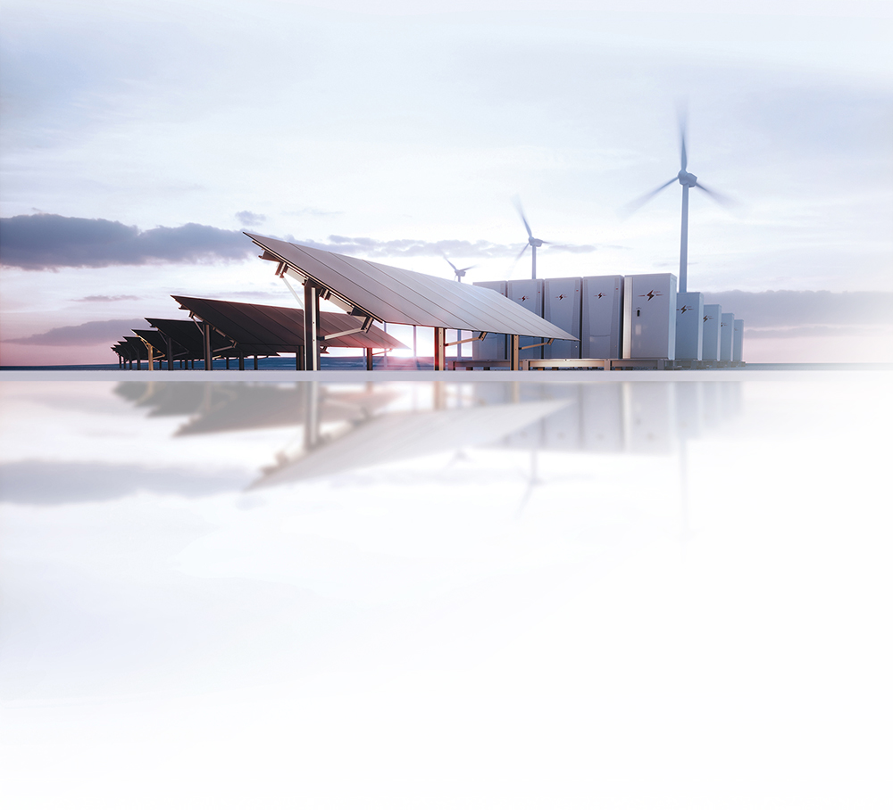


Delivering reliable, cost-effective Transmission Solutions that achieve the Clean Energy Future we all desire.

Slide 2
Transitioning to the Grid of the Future
requires Widespread Collaboration
and Thoughtful Planning
Targets for economy-wide decarbonization Changes in supply and demand Planned grid solutions including new technologies Policies to develop and fund the future energy system

Slide 3
A Low-Carbon Future requires all sectors to be a Part of the Solution
Economy-Wide Emissions in New England
172 MMT CO₂
in 1990
132 MMT CO₂
in 2020
New England electric sector emissions have reduced dramatically over the past three decades
Net Zero targets require more aggressive emission reductions
34.6 MMT CO₂
to meet “80% reduction by 2050”
Source for 1990 and 2017 emission: EIA. State Carbon Dioxide Emissions Data. October 23, 2019 (Revised January 23, 2020). https://www.eia.gov/environment/emissions/state/

Slide 4






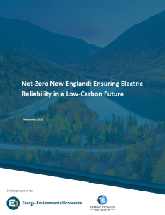

Multiple Independent Studies show several possible Pathways to Decarbonization
Widespread agreement that all cost-effective, reliable outcomes require: Dramatic increases in electric vehicles and zero-carbon heating Substantial increases in solar, offshore wind, storage and energy efficiency Significant additional transmission capacity and a modern grid

Slide 5
Achieving decarbonization goals will Increase Electric Demand and Change Demand Dynamics
Potential Annual New England Electric Demand
Electrification increases gross demand by at least
65% by 2050
Gross Demand
Demand response, energy efficiency, and distributed solar PV will continue to reduce net load

Slide 6
Increased demand will require Significant Growth in Supply
Illustrative Supply Mix Scenarios That Reliably Meet New England State Decarbonization Goals
Storage
500% increase in installed solar PV capacity by 2040 Offshore wind growth from only 30 MW to 15 GW by 2040 2–5 GW of new imports to balance intermittent renewables
Hydrogen, RNG
Offshore Wind
Onshore Wind
Imports
BTM Solar
Utility Solar
Gas, Nuclear, Hydro, Other
Source: London Economics International, LLC capacity expansion and hourly economic simulations of multiple decarbonization scenarios
6

Slide 7
Balancing resources are key to reliably Integrating Clean Energy
Eversource analysis shows the need for 3–10 GW of storage resources by 2040
To limit emissions, natural gas generation will run less often, but is needed to maintain reliability during large demand swings
Clean fuel technologies, such as RNG and hydrogen, may enable low-carbon, dispatchable resources
Hourly Supply and Demand for a Day in August 2040
Storage charging from excess solar
Storage discharging to meet demand
Source: London Economics International, LLC capacity expansion and hourly economic simulations of multiple decarbonization scenarios
Notes:
Storage references:
-About 20MW of storage interconnected 2015-2020
-About 2,500 MW of storage in the queue
-Pumped hydro = ~2GW, these numbers are in addition to that
Reference for 20GW daily swing:
-all time peak in new England ~26GW
-average intra-day swing today is around 6GW, so looking at more than 3x increase

Slide 8
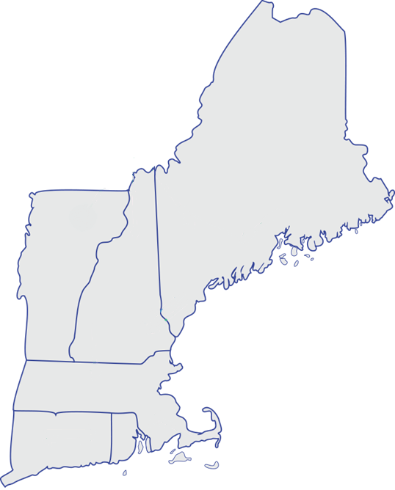
Electric grid must be transformed to achieve Decarbonization Goals
CRITICAL INTERFACES FOR 2040
Massachusetts 2050 Roadmap
  All scenarios require between
  2.7–4.8 GW of new transmission capacity between ISO-NE
  and Quebec
CT Integrated Resource Plan
  Transmission upgrades reduce renewable curtailments and increase financial benefits to customers by up to $752M
ISO-NE 2019 Economic Study
  Effectively interconnecting offshore wind to meet state targets will require significant transmission upgrades across New England
HQ Import/
Export
Surowiec South
North-South
ME-NH
East-West
CT import
SEMA/RI Export
8

Slide 9
Grid planning must accommodate a range of Potential Decarbonization Pathways
Inputs
Outputs
Scenarios based on different possible combinations of decarbonization alternatives
Grid solutions to reliably and affordably integrate clean energy
. . . . . . . . . . . . . . . . . . . . . . . . . . . . . . . .
Advanced Modeling
. . . . . . . . . . . . . . . . . . . . . . . . . . . . . . . .
  Potential Future Generation
  Generation Retirements
  Electrification Forecasts
  Energy Storage
  Energy Efficiency
  Weather Scenarios
  Customer Behavior
  Co-optimized solutions to achieve multiple objectives
  Markets and policies to support solutions
  Siting enhancements for regional infrastructure

Slide 10
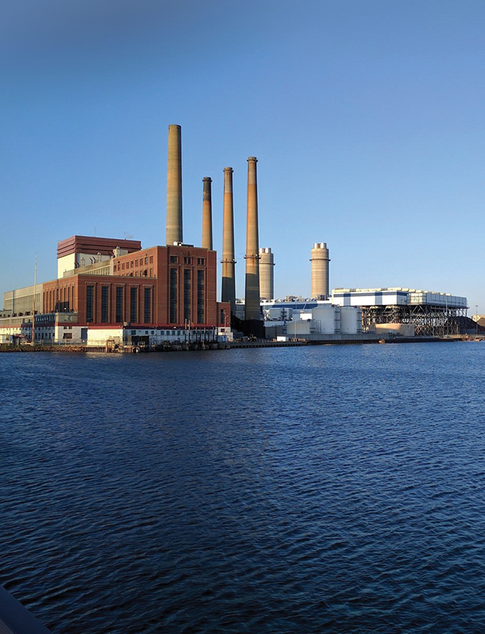
Enabling fossil plant retirement with a Reliable, Clean and Cost-Effective transmission solution
Mystic Generating Station to retire by June 2024
Competitive transmission solicitation held to
address system impacts
Eversource/NGRID’s Ready Path solution selected;
high confidence and lowest cost option using upgrades at several existing substations
Key Benefits:
  Significant customer savings; $48M project cost well below
  $175M annually that customers pay to keep plant available
  Maximizes use of existing transmission facilities, minimizing potential environmental impacts
  In-service eight months before Mystic’s retirement
  Eliminates 1400 MW carbon-emitting generation resource
Mystic Generating Station Everett, MA

Slide 11
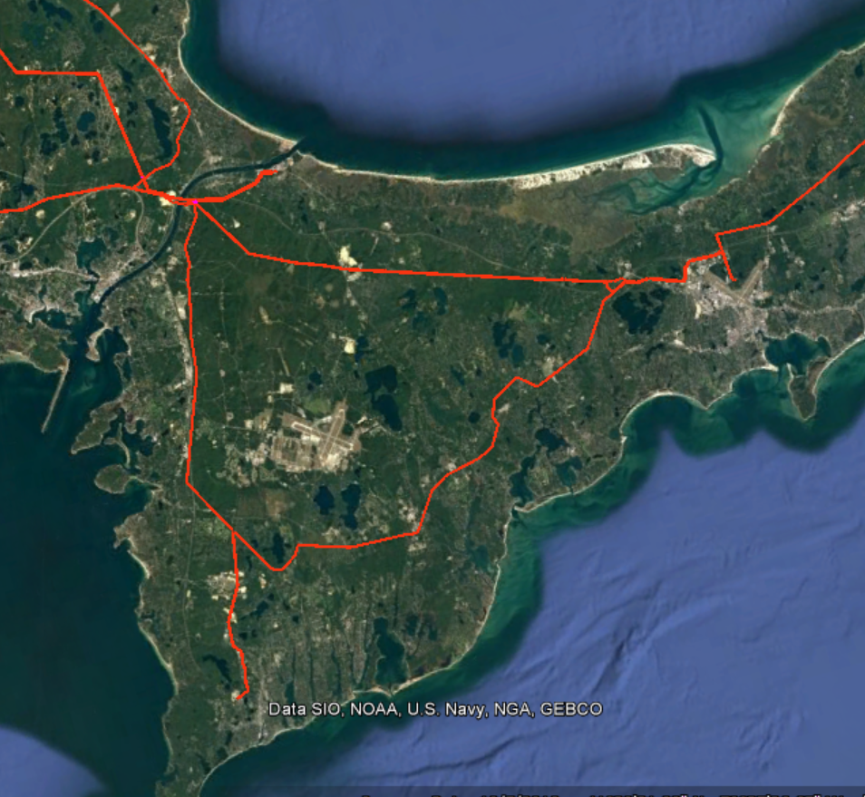
Integrating Transmission Reliability Projects and Generation Interconnections
Pursuing transmission investments to enable interconnection of 1,600 MW of offshore wind in our service territory Efficient use of our rights of way and electric infrastructure by co-optimizing reliability improvements and clean energy integration Coordinated planning for additional interconnections
Reliability Upgrades
1600 MW
Interconnections
Additional potential interconnections

Slide 12
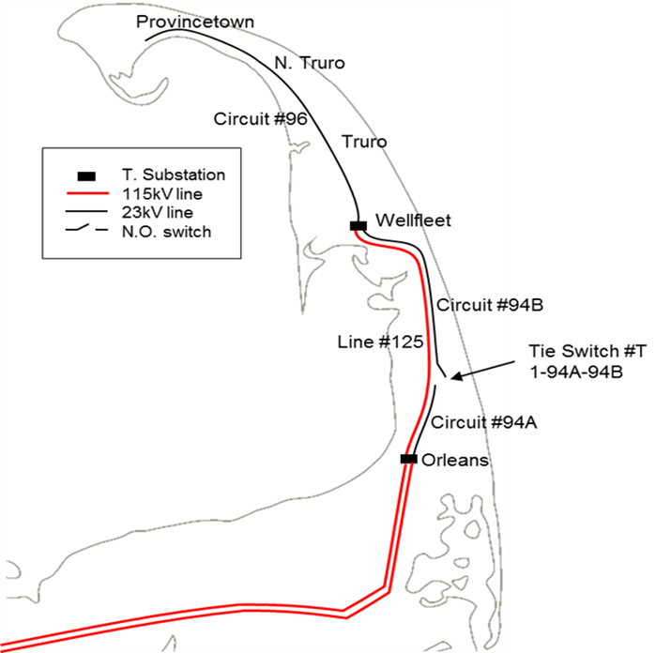
Deploying Innovative Energy Storage Solution to meet customers’ energy needs
Constructing a 25 MW battery storage project on Cape Cod to improve resiliency
Avoids a 13-mile line through the Cape Cod National Seashore
Located in Provincetown, the battery will supply load from Provincetown to Orleans
Project is technically complex, requiring extensive planning studies and innovative grid design solutions
12

Slide 13
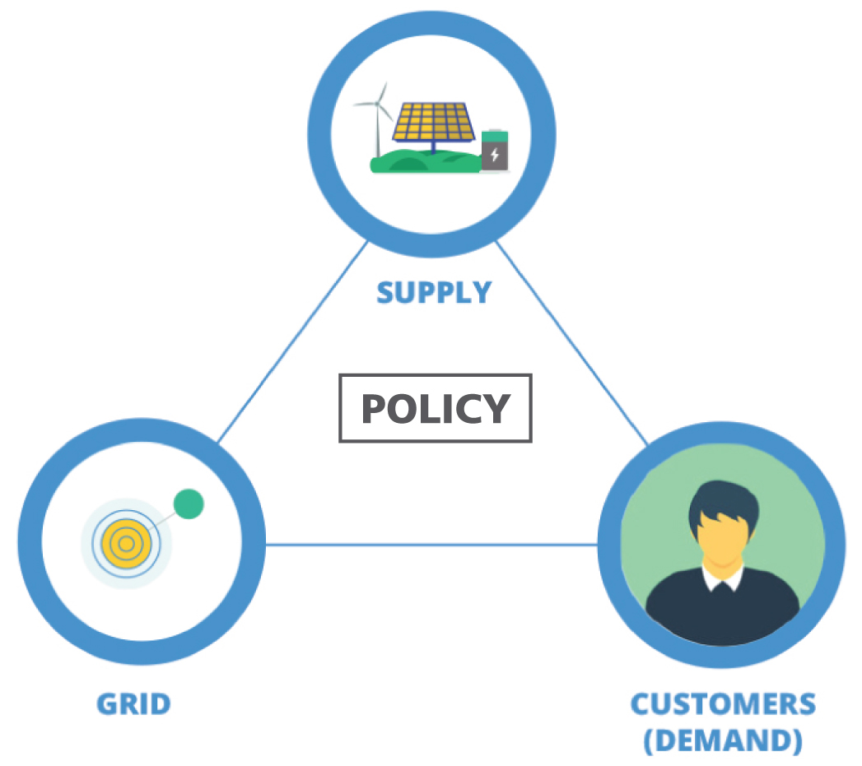
A Reliable, Cost-Effective Clean Energy Future
Grid solutions to enable power plant retirements and interconnect large-scale renewable resources Strategic investments to support increasing customer-owned distributed generation Initiatives to replace aging infrastructure and improve system reliability and performance
Notes:
Priority must be placed on meeting customers’ energy needs reliably and affordably
Transmission planning must evolve thoughtfully and avoid creating increased delays and costs
“Cluster study” approach should consider and balance reliability and other factors
States, ISO-NE and market participants must work collaboratively to realize decarbonization goals

