Slide 1
Rethinking Transmission Planning:
Meeting the Region’s Clean Energy Goals
NESCOE Transmission Planning Technical Conference
Marc D. Montalvo
February 2, 2021
DRAFT

Slide 2
The region’s high-level policy objectives are aligned
New England’s shared strategic goal is to dramatically reduce the amount of carbon dioxide that the electricity industry produces, while ensuring the long-term affordability and reliability of the electricity service it provides.
New England states have targeted 30% to 45% by 2030 and 80% or net-zero by 2050 in their decarbonization policies and goals.

Slide 3
NESCOE VISION: TRANSMISSION PLANNING STUDY GOALS
Apply a transmission planning framework that provides a credible roadmap to meeting the States’ energy transition; the resulting plans must:
  Maximize the use of existing transmission
  Add new transmission only where (and when) necessary
  Assume the use of competitive processes to minimize costs to consumers
Start with scenarios already developed and used in the States’ analyses of pathways to decarbonization to level-set stakeholders’ understanding of transmission needs and the estimated costs
Structure the planning studies to provide insights into:
  Onshore system upgrades, including specific areas that need strengthening
  Offshore systems that may be needed to support offshore wind resources
  Potential options that should be explored, including non-transmission alternatives
  The impact of DERs (both distributed generation and flexible load sources) on transmission needs
Conduct stakeholder meetings to discuss the ways that transmission might enable the integration of targeted clean energy resources into the region, and the performance and cost tradeoffs

Slide 4
Questions THIS transmission plan SHOULD answer
Many of the targeted resources will interconnect on the edges of the system. What infrastructure is needed to integrate those resources?
For example, even if upgrades are made to allow projects to connect to the Cape Cod area, the cluster study does not address moving that energy off the Cape.
  If this energy delivery issue is not addressed, the system is being planned into serious congestion with built in limits on its ability to deliver the state mandated clean energy to customers.
If network improvements are only made to deliver the capacity value of the renewable, what happens to the energy produced above that capacity MW?
Under light load conditions (already experienced), where will excess energy go, or will it be curtailed?
Are inter-ties with our neighbors sufficient to sell this excess clean energy to others?
Can energy storage well beyond the existing pumped storage hydro play a role?
Electrically, how will voltage be controlled on a very lightly loaded power system?
Will system stability become an issue as traditional synchronous resources will be decommitted in favor of new, clean energy resources?
If NY is in the same position as NE, how do we collectively share this energy with PJM, Ontario, Quebec, or the Maritime Provinces?

Slide 5
Motivation: Why rethink how we do planning
DISTRIBUTED DECISION-MAKING | Limited information exchange amongst the principals responsible for planning and using the system components
DYNAMIC ENVIRONMENT | Limitations of deterministic (static sequential) approaches to transmission planning considering the increasing penetration of renewable energy sources and the dynamic market and policy environment for which the system is being planned
NEW TECHNOLOGIES | Limited consideration of the potential supporting role and impact of demand-side participation, distributed power generation, advanced controls and FACTS (and D-FACTS), and energy storage
IT’S NOT FREE | Transmission elements are expensive long-lived assets and choices made today about what to build where and when will have lasting consequences to power system performance and consumer costs

Slide 6
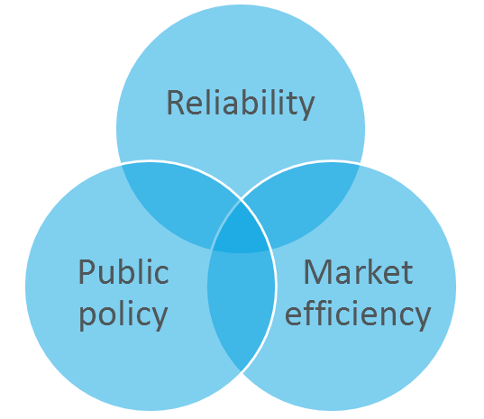
IDENTIFYING STRATICALLY ALIGNED PLANS
Recognize that transmission is a strategic asset for the region
Tradeoffs: curtailments – upgrades – storage
How do we measure system performance and select preferred packages of upgrades?
What is the “planned for” transmission network intended to accommodate?
How do we determine when to build? Timing matters. Assess embedded optionality.

Slide 7
Addressing transmission infrastructure constraints
Requires a practical and robust transmission plan that recognizes that the system is being built into an uncertain future and that it should be able to efficiently accommodate multiple future states without incurring material incremental costs – the plan must value flexibility and optionality
Requires a strategic view of power system expansion alternatives—recognizing bottom-up and top-down impacts and the ability of upgrades at the bulk level to positively or adversely impact performance and costs down stream and visa-versa through time given policy imperatives
Requires adoption of a portfolio view of transmission plan performance that considers the location and timing of interconnected elements (generation, loads, market structure, and associated dependencies)

Slide 8
Identifying a “good” transmission plan requires a broader set of performance measures
How do we measure system performance and select preferred packages of upgrades?
Consider measuring transmission plan performance with the following metrics
Measures of improved infrastructure utilization and competition
Decrease in annual congestion cost (opportunity cost of using transmission) divided by annual transmission investment cost
Decrease in weighted standard deviation of mean of LMP (flatness of the supply curve) divided by annual transmission investment cost
Measures improved cost to meet policy goal
Increase in annual delivered renewable MWh divided by annual portfolio investment cost
Related metrics
Electrical/contingency response (steady-state and dynamic)
Portfolio cost (total installed cost of transmission and enabled renewables to meet policy goals)
Market efficiency gains (production cost savings or reduced congestion costs on key interfaces/avoidance of new interface constraints)
Planning reserve requirement reductions
Avoided renewable production curtailments
Avoided CO2 emissions

Slide 9
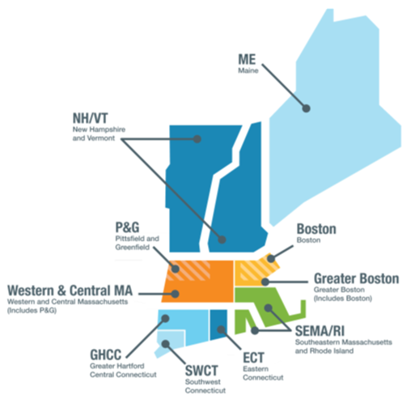
Multi-Value project (MVP) perspective
In MISO, for example, the overall goal for the MVP portfolio analysis was to design a transmission portfolio that enabled the siting of renewable resources to meet public policy, while maximizing the measured economic benefits on a regional system level.
The portfolio was designed using reliability and economic analyses, applying several futures scenarios to determine the robustness of the designed portfolio under a number of future potential energy policies.
Source: ISO New England 2019 Regional System Plan

Slide 10
THE TRANSMISSION SYSTEM IS A STRATEGIC ASSET
Coordination, via careful planning and well-structured markets, increases efficiency, and reduces waste and costs
Infrastructure
Regulation
Markets
Broad-based stakeholder engagement
Clear articulation of strategic planning objective
Align incentives
Address new risks and uncertainty
Embrace new and emerging technologies
Rethink borders

Slide 11
Thank you
Let’s continue the conversation
Marc D. Montalvo
(617)778-2434 mmontalvo@daymarkea.com
DAYMARK ENERGY ADVISORS
Our team brings deep knowledge of energy infrastructure, regulation, and markets to help our clients make well-informed business, capital investment, and policy decisions in the face of uncertainty.
DaymarkEA.com

