Slide 1
February 2, 2021
Transmission Planning in New England
New England Energy Vision for a 21st Century Electric Grid Technical Forum
Robert Ethier
Vice President, System Planning

Slide 2
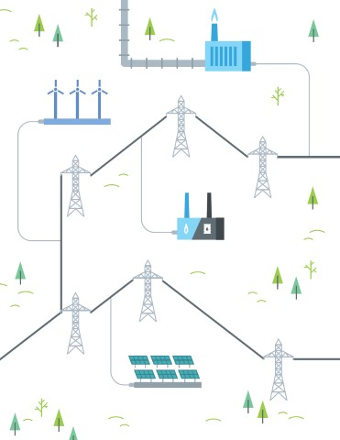
Key Themes
The focus of most planning to date: Transmission upgrades driven by clear, narrow scope to address reliability needs and interconnect new resources
How the system is changing: Integration of renewables and storage to meet policy goals may significantly change transmission system flows
How planning could change: Meeting policy goals in a timely and efficient way will require new planning, approval, and funding approaches. Future transmission planning would be driven by both reliability standards and other policy objectives; this will require greater engagement with states and stakeholders

Slide 3
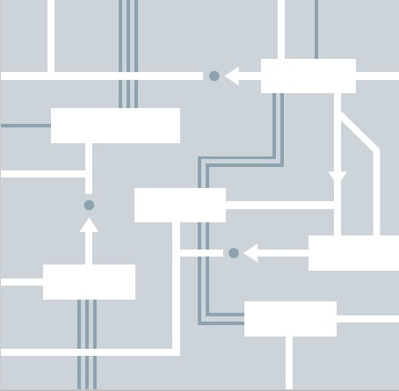
Three Transmission-Related Questions for Envisioning a Decarbonized Electric System
How does transmission planning work today?
What transmission infrastructure do we need to build to support a fully decarbonized electric grid?
What processes do we need to put in place to get there?
As the Regional Transmission Organization, the ISO is required to identify transmission infrastructure solutions that are essential for maintaining power system reliability in New England

Slide 4
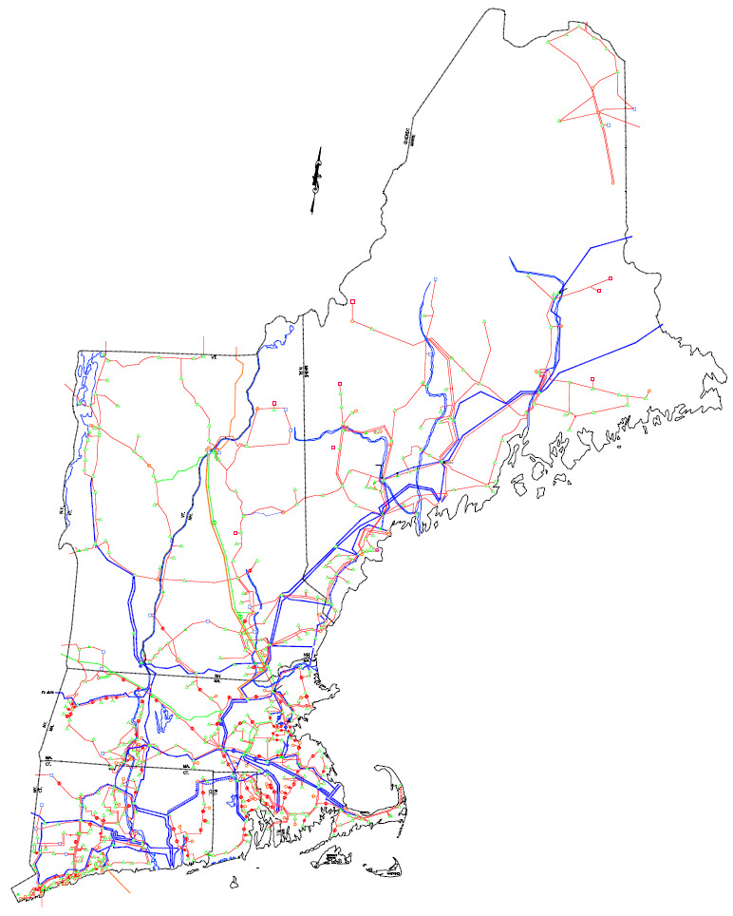
New England’s Transmission Grid Is the Interstate Highway System for Electricity
9,000 miles of high-voltage transmission lines (115 kV and above)
13 transmission interconnections
to power systems in New York and
Eastern Canada
21% of region’s energy needs met
by imports in 2020

Slide 5
Transmission Planning today
Transmission planning under the current ISO-NE Tariff

Slide 6
Transmission Needed for Reliability
The ISO has specific, limited authority to trigger construction of regionally funded transmission
    The ISO does periodic studies of sub-areas (e.g. Western MA) to identify violations of reliability standards within a ten year horizon
    Needs driven by changing load and generation patterns; solutions put on the RSP Project List
  Historically, the ISO designed upgrades with the relevant Transmission Owner(s)
    $11.3 billion invested to date to strengthen transmission system reliability since 2002 (e.g., Greater Boston, Southeast Massachusetts, Southwest Connecticut, Maine Power Reliability Program); an additional $1.1 billion is planned (ISO Transmission Project List)
  Today and in the recent past the ISO identifies needs that occur either in the near term (i.e., within three years), or the longer term (beyond three years)
    For near-term needs, the ISO designs upgrades with the relevant TO(s)
    For longer-lead time needs, the ISO issues a competitive solicitation (RFP) for transmission solutions and then evaluates proposals submitted in response to the RFP (e.g., Boston Area)
  New England has a regional cost-sharing arrangement for reliability projects
Stakeholders have opportunities to be involved in the planning process through the Planning Advisory Committee (“PAC”)
The ISO’s role is to select a cost-effective and comprehensive solution to the reliability need

Slide 7
Developer-Sponsored Transmission
Developer-sponsored projects are voluntary and not related to regional reliability needs; may be driven by economics or other factors (known as Elective Transmission Upgrades (ETUs) in the ISO Tariff)
  For example, developers have proposed large-scale transmission projects to deliver clean energy in response to state RFPs
  Costs are born by developers, who have required long-term contracts to provide funding
The ISO’s role is to ensure that the interconnecting transmission project does not have an adverse impact on system reliability
Currently, this is the primary mechanism that state-sponsored projects have used to expand access to clean energy resources (e.g., Massachusetts solicitation for clean energy resources and the New England Clean Energy Connect (NECEC) project)
  While a collection of states could also potentially use a unique arrangement (outside of the ISO Tariff) to fund an upgrade, this has not yet happened

Slide 8
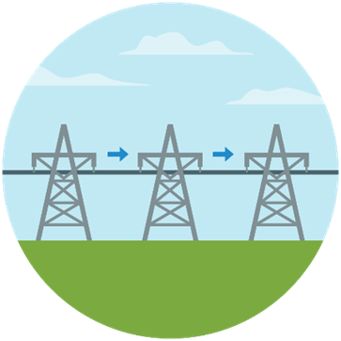
Competition for Transmission Solutions
In December 2019, the ISO issued an RFP for competitive transmission solutions to identified reliability needs in the Boston Area
Reliability needs are driven by the anticipated retirement of the Mystic Generating Station in the Boston area
The ISO received 36 proposals from eight qualified entities
  Costs ranged from $49M to $745M
  In-service dates ranged from March 2023
  to December 2026
The ISO selected the lowest-cost solution that fully met the identified reliability needs in the area

Slide 9

Transmission Planning for Public Policy
FERC initiated this mechanism through Order 1000
  In theory, intended to enable ISO to plan to meet public policy objectives
  The ISO initiates the process every three years (2017, 2020)
  Mapped out in ISO-NE Transmission Planning Process Guide*
The New England states, NESCOE, and
stakeholders can provide input to identify public policy needs that may require transmission
The process has not resulted in an identified public policy need; the states have indicated that they want to rethink this process
*https://www.iso-ne.com/static-assets/documents/2020/03/transmission_planning_process_guide_3_13_20.pdf

Slide 10
ISO New England Performs Annual Economic Studies as Requested to Inform Policymakers and Stakeholders
Three studies were requested in 2019: one was requested in 2020
No direct path to building transmission unless upgrades that sufficiently reduce regional production costs are identified (these upgrades could proceed as Market Efficiency Transmission Upgrades)
Sample Requester | Purpose of Request
2019 New England States Committee on Electricity (NESCOE) | Impacts on transmission system and wholesale market of increasing penetrations of offshore wind resources Preliminary results show no major new transmission is needed for up to 7,000 MW of new offshore wind*
2019 Anbaric Development Partners (Anbaric) | Impacts on energy market prices, air emissions, and regional fuel security of large penetrations of offshore wind resources Results similar to NESCOE results
2020 National Grid | Analyze potential pathways to best use the MWh of clean energy resources to meet state goals cost-effectively, leveraging transmission and/or storage as needed. Results pending
*The 7,000 MW was in addition to 1,000 MW of offshore wind assumed in the base case

Slide 11
Transmission planning in transition
Trends already underway will likely accelerate in the future

Slide 12
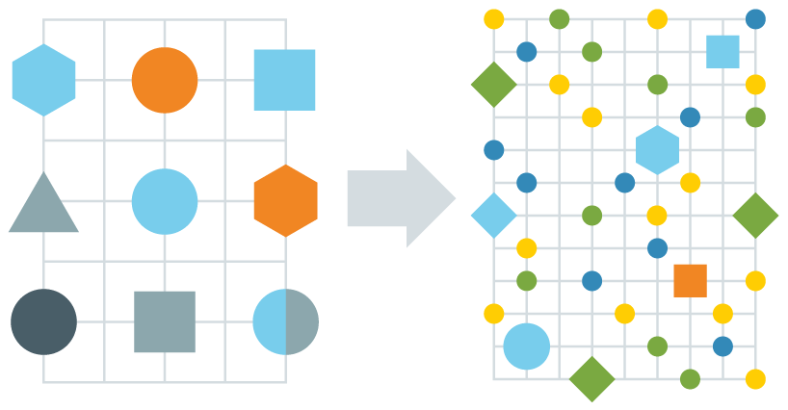
New England Is Moving Toward a Hybrid Grid
There are two dimensions to the transition, happening simultaneously…
1
A shift from conventional generation to renewable energy far from loads
2
A shift from centrally dispatched generation to distributed energy resources on distribution system
Coal
Oil
Nuclear
Gas
WIND
Solar
Storage & other technologies
Maintaining reliable power system operations becomes more complex with the shift to greater resources that face constraints on energy production

Slide 13



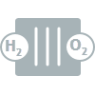




Wind Power Comprises Two Thirds of New Resource Proposals in the ISO Interconnection Queue
All Proposed Resources
Proposals by State
(all proposed resources)
State | Megawatts (MW)
Massachusetts | 12,565
Connecticut | 7,457
Maine | 2,142
Rhode Island | 1,287
New Hampshire | 572
Vermont | 105
Total | 24,129
TOTAL
24,129 MW
Source: ISO Generator Interconnection Queue (January 2021)
FERC and Non-FERC Jurisdictional Proposals; Nameplate Capacity Ratings
Note: Some natural gas proposals include dual-fuel units (with oil backup).
Some natural gas, wind, and solar proposals include battery storage.
Source: ISO Generator Interconnection Queue (January 2021)
FERC and Non-FERC Jurisdictional Proposals

Slide 14

ISO-NE Forecasts Continued Strong Growth in Solar Photovoltaic (PV) Resources
August 2020 Solar PV
Installed Capacity (MW_{ac})
State | Installed Capacity (MW_{ac}) | No. of Installations
Connecticut | 636.28 | 50,351
Massachusetts | 2,480.05 | 109,959
Maine | 60.35 | 5,572
New Hampshire | 116.44 | 10,300
Rhode Island | 175.89 | 9,028
Vermont | 379.41 | 14,658
New England | 3,776.41 | 199,868
Note: The bar chart reflects the ISO’s projections for nameplate capacity from PV resources participating in the region’s wholesale electricity markets, as well as those connected
“behind the meter.” The forecast does not include forward-looking PV projects > 5 MW in nameplate capacity. Source: Final 2020 PV Forecast (March 2020) and August 2020 Distributed Generation Survey Results; MW values are AC nameplate.
Notes:
Mention concept of cluster studies and note Western MA clusters in Appendix

Slide 15
Future Transmission planning

Slide 16
What Will the Transmission System Look Like in the Future?
How will the region accommodate the next wave of large-scale renewable energy deployment after using up the initial points of interconnection (i.e., generator retirement sites)?
Should the region proceed with ad hoc interconnection studies to integrate renewables or consider proactive plans to integrate renewable energy on a larger scale?
How will the distribution systems evolve to accommodate growth of distributed resources and electrification of transportation and heating sectors?
The ISO looks forward to working with the New England states to reliably plan and build a decarbonized transmission grid

Slide 17
Future Transmission Planning Considerations
If the region wants to integrate large amounts of wind or grid-scale renewables in a timely and cost-effective manner, the ETU and Public Policy Process may need to be revised or may not be sufficient
A regular study process focused on public policy goals can provide detailed information
  E.g., proposed 2050 Transmission Study requested by certain states
Integration of/coordination between the reliability-based upgrade process and any long-term public policy development process is needed
  E.g., to make sure reliability upgrades are an appropriate technology and sized to meet public policy goals
A defined process for approving public policy upgrades and determining cost allocation is essential
  Unlikely that sufficient specific criteria can be identified to allow the ISO to simply add public policy projects to the Project List
  Experience with cluster studies show that identifying the needed upgrades may not be fruitful if the procurement process is not ready to fund the cost of the upgrades along with the new resources themselves
    There are many cases of completed interconnection studies in the ISO queue where no upgrades are required – but the project is not moving forward because the generator itself cannot secure funding
  Some formal state approval likely needed
    Combined with siting?
    Combined with cost allocation?

Slide 19
Appendix

Slide 20
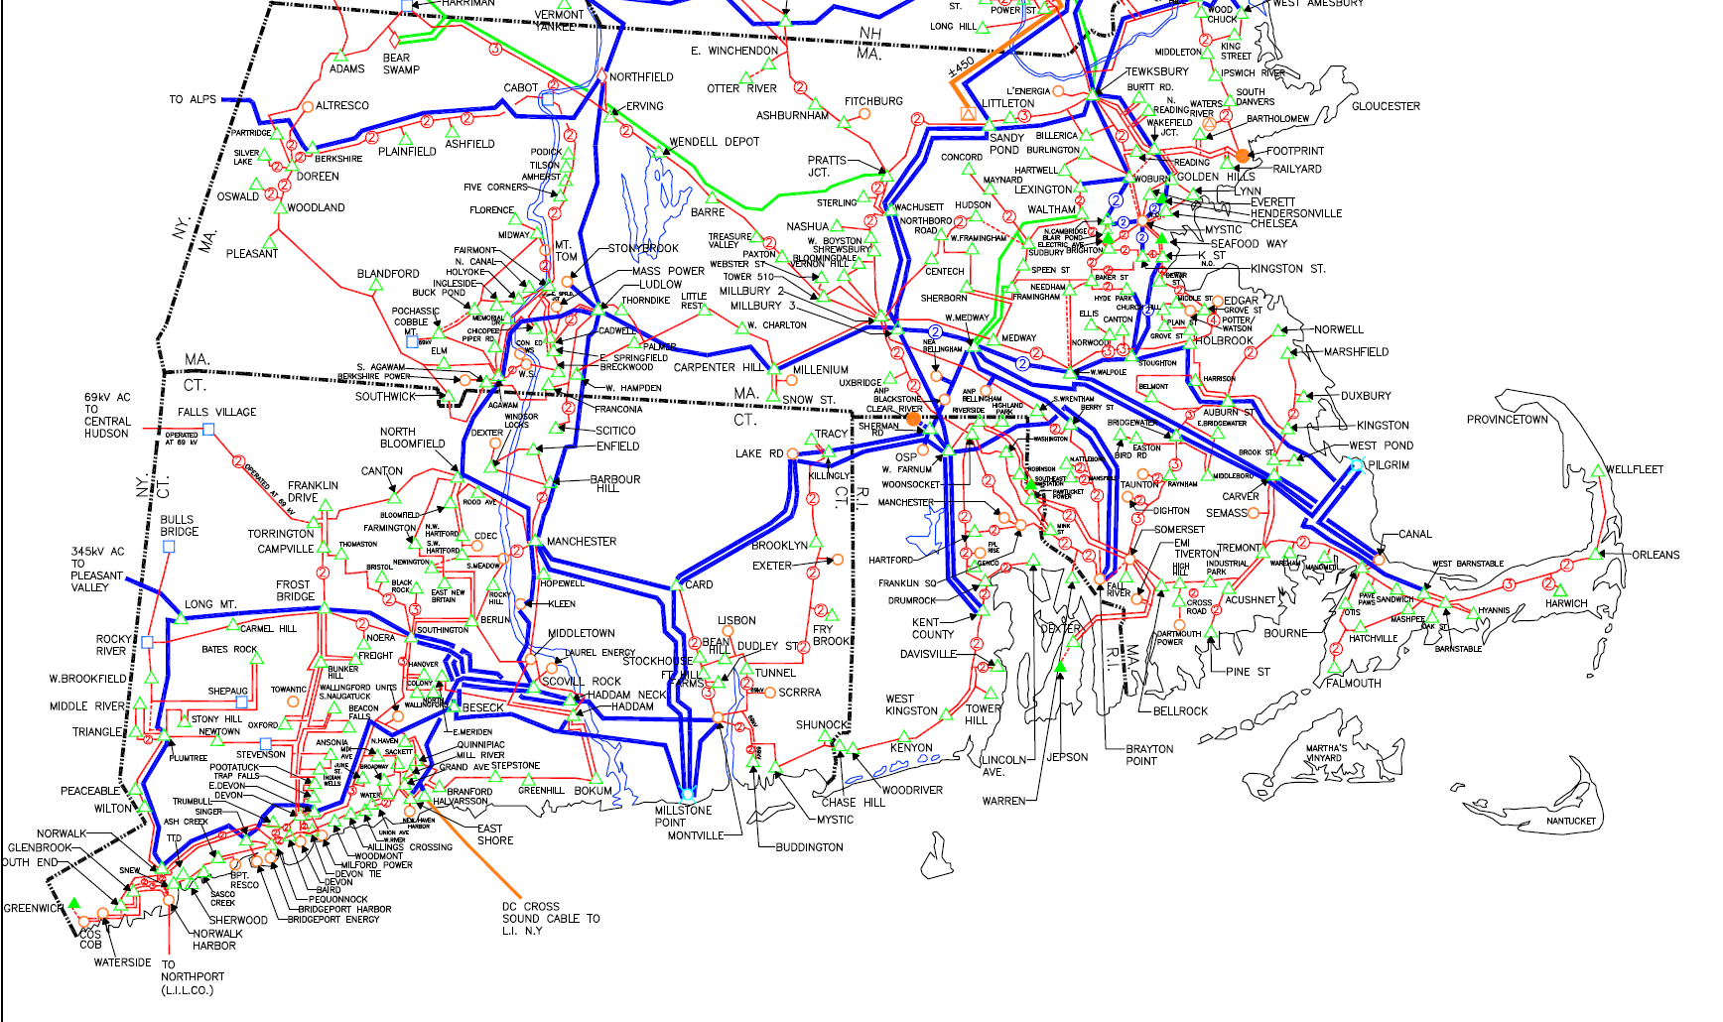
2019 NESCOE Economic Study of Potential Interconnections for Offshore Wind
Considered in economic studies for NESCOE and Anbaric
Based on the currently
expected transmission
system for 2030, the ISO
anticipates that approx.
7,000 MW of offshore
wind additions have the
potential to avoid major
additional 345 kV
reinforcements*
The transmission system was
modeled using 2030
internal transmission-
interface transfer
capabilities
Assumes certain resource
retirements have occurred,
including Mystic 8 & 9
Possible offshore wind additions* (MW and location)
Mystic (MA): 1,200 MW
Bourne/Canal/Pilgrim (MA): 2,400 MW
Brayton Point (MA): 1,600 MW
Montville (CT): 800 MW
Kent County/Davisville (RI): 1,000 MW
*Some 345 kV reinforcement/expansion may still be needed for this scenario. This anticipation is preliminary (system impact studies have not been completed for all of these MW). This anticipates minimal interconnection at nameplate levels and capacity interconnection at intermittent capacity values – does not anticipate all of the MW being able to run simultaneously at nameplate levels at all times on the system. The 7,000 MW was in addition to 1,000 MW of offshore wind assumed in the base case

Slide 21
Western MA Distributed Energy Resource (DER) Cluster Case Study
The Transmission Owners, coordinating with the ISO, have completed group studies of DERs (known as cluster studies) seeking to interconnect to the Western MA distribution system, with a subsequent cluster studies ongoing
While first study enabled most resources to interconnect with minimal upgrades, many resources have withdrawn from second study, possibly after seeing upgrade costs
  First Western MA cluster study (approved at the November 2019 NEPOOL Reliability Committee (RC)) accommodated 312 MW of DERs with few upgrades
  The second round studied an additional 391 MW (May 2020 RC), identifying significant transmission and distribution upgrades
  157 MW withdrew from this second round, resulting in a revised cluster study (October 2020 RC), with fewer upgrades
Lessons learned
  Region is quickly hitting limits of the distribution system to accommodate additional DERs without costly upgrades
  Developers often withdraw rather than pay for upgrades
  Distribution flows are creating issues on the transmission system
How to accommodate public policy on the distribution system
  Do we need a public policy expansion process for the distribution system that parallels the one we develop for the transmission system?
  Do we needed a smarter distribution system, the development of which is coordinated with the transmission system?

Slide 22
The ISO Interconnection Queue: Looking Back to 2015
Natural gas was the primary fuel, and the total queue was half of 2020
All Proposed Resources
Proposals By State
Key:
Technology, Megawatts, Percentage
Total Capacity:
Approx. 9,500 MW
Note: Some natural gas include dual-fuel units (oil)
Source: ISO Generator Interconnection Queue (January 2015)
FERC Jurisdictional Proposals Only

