Slide 1
Scenario planning and AEMO’s Integrated System Plan
Transmission Planning Technical Conference, Massachusetts; February 2, 2021
Craig Price, Group Manager, System Planning, AEMO

Slide 2
Agenda
Context
Why do we need to do integrated system planning
How do we do integrated system planning
        Stakeholder engagement
        Scenario planning
        Integrated systems modelling
    The 2020 ISP

Slide 3
Context

Slide 4
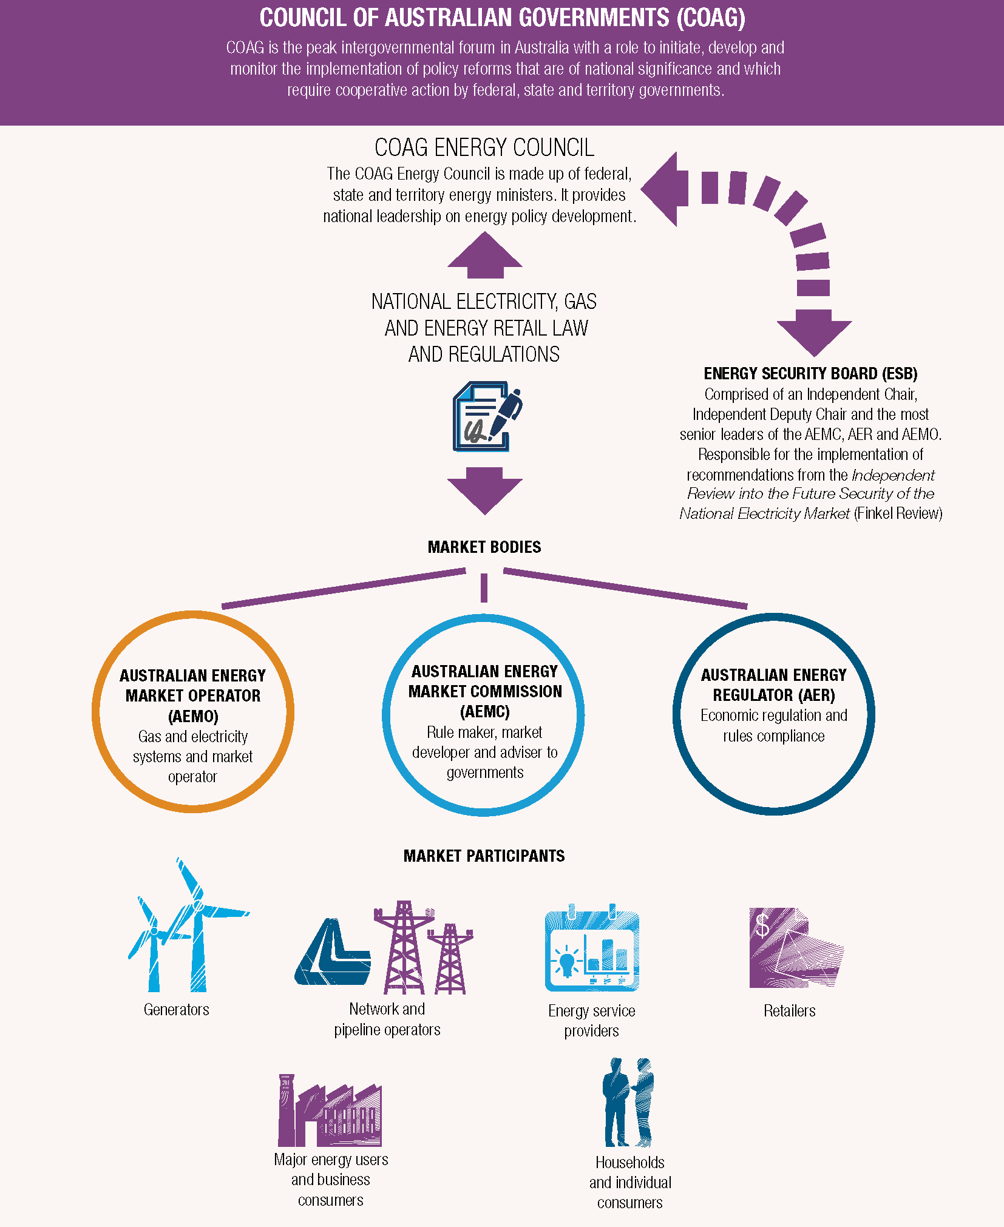




Australian Energy Market Structure

Slide 5
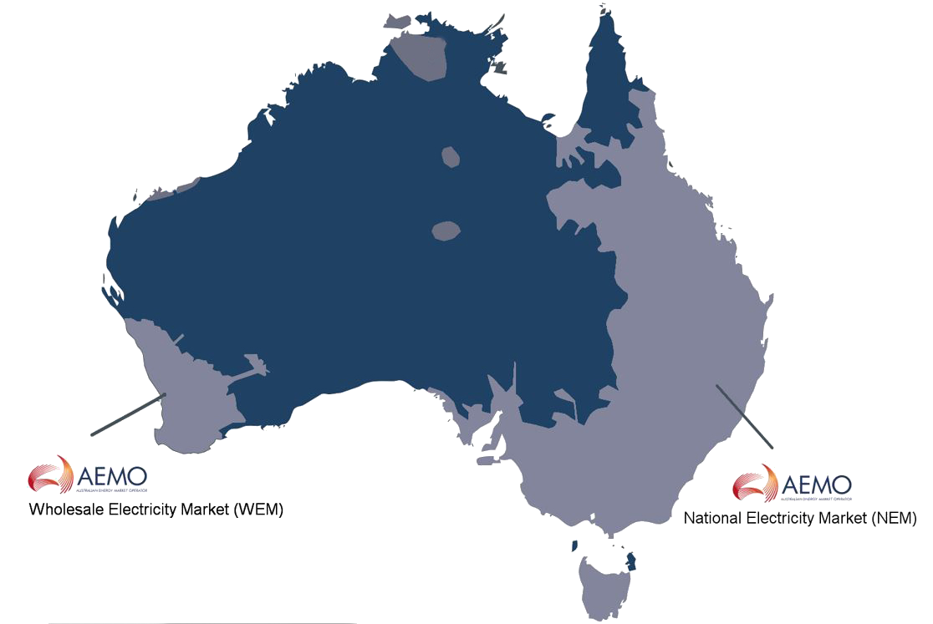

We operate and plan Australia's power grid in Australia’s eastern and south-eastern seaboard, under the NEM;
We also operate the Wholesale Electricity Market and power grid in south-west WA:
We also forecast and advise the NT government in planning the NT’s power systems.
About AEMO
The markets supply about 200 terawatt hours of energy each year, after distributed energy supplies on the consumer premises are accounted.
We also operate retail and wholesale gas markets across south-eastern Australia and Victoria’s gas pipeline grid.
Collectively traded more than
A$20 billion in the last financial year.
AEMO’s Ownership
40%
60%
Market
participants
Governments of Australia

Slide 6
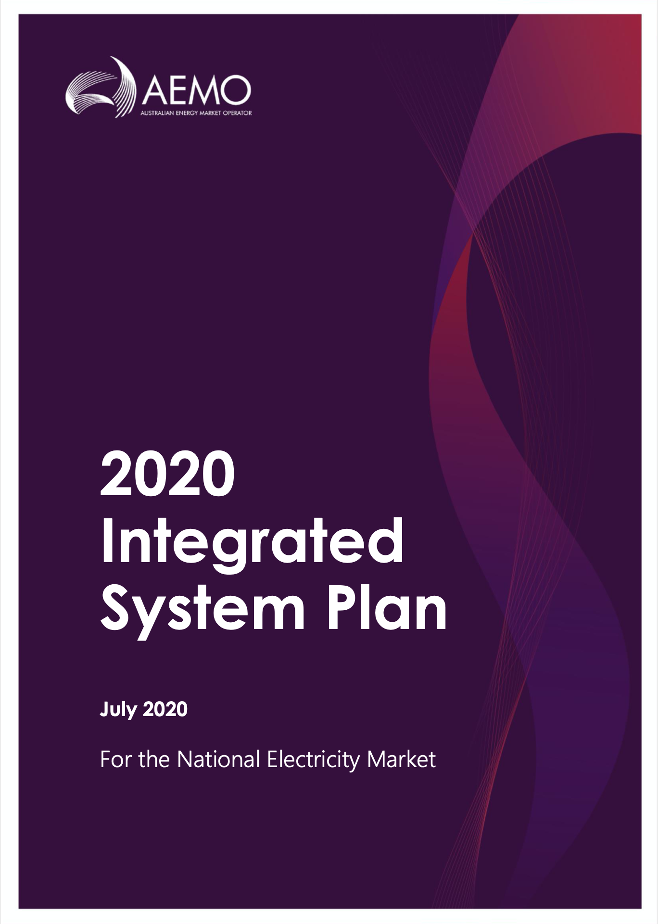
What is the ISP?
A whole-of-system integrated energy plan and roadmap for transformation of the energy system
That maximises value to end consumers
And utilises the opportunities provided from existing technologies and anticipated innovations
It informs policy makers, investors, consumers, researchers and other energy stakeholders

Slide 7
Why do we need to do integrated system planning?

Slide 8
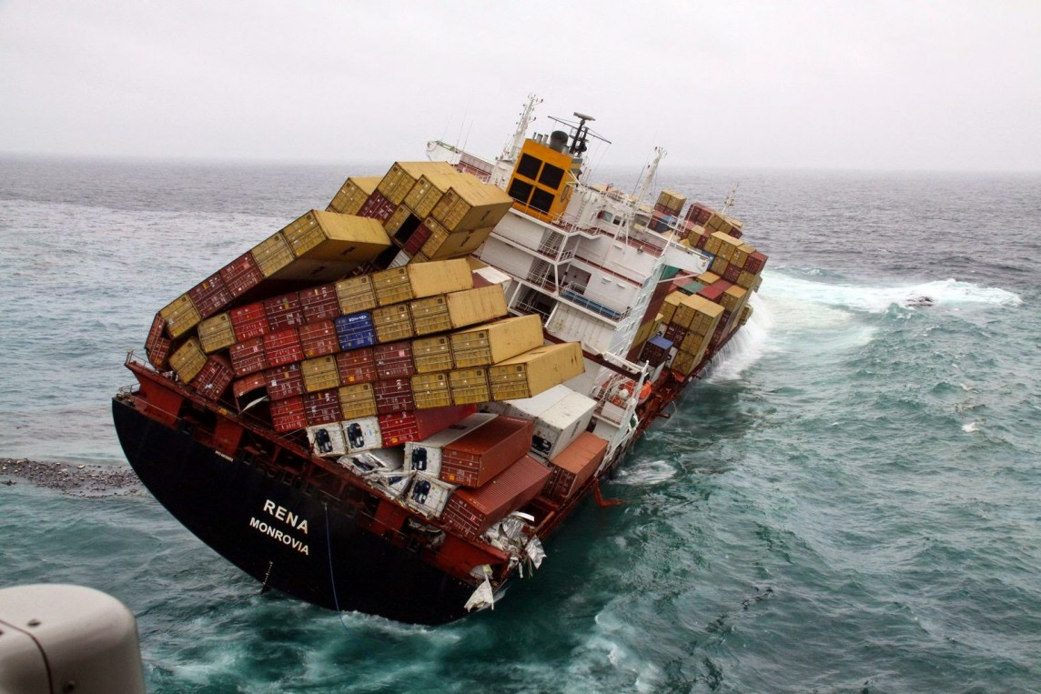
Our industry is in disruption

Slide 9
Drivers of disruption
Diverse,
Variable,
Unpredictable
Supply and
Demand
Weather and
climate changes
Reduced
Resiliency
Supply
sources
Ageing
infrastructure
Faster and More Granular
New
Areas of Vulnerability
Energy
industry
New
service
models
Unknown
Reduced Visibility
New players
Cyber
security
Consumer
preferences
Electronic vs
Synchronised
Resources

Slide 10
Energy mix and infrastructure are rapidly transforming
  A rapidly changing world:
    Supplies are geographically dispersed and technologically diverse
    Demand peaks more pronounced, minimums dropping below regional demand
    New extremes and new vulnerabilities emerging
    Requiring:
      Flexible, dispatchable plant and energy storage
      Visibility and controllability of resources, including embedded (consumer) resources
      Efficient re-design of the entire power system, from consumer to supply
      Efficient integration of new technologies to provide essential system services
      Rapid evolution of two-way power systems and markets
A static world:
A power system designed for bulk energy transport on main flow paths from major (synchronous) generation centres to bulk supply points, and via distribution to consumers (one-way)
Predictable demand growth and incremental and slow change in the power system
Simple energy-only, one-way markets, that largely externalised essential system services
TO

Slide 11
How do we do Integrated System Planning
Stakeholder engagement
Scenario planning
Integrated systems modelling

Slide 12
Engagement with our stakeholders is key to meeting their needs

Slide 13
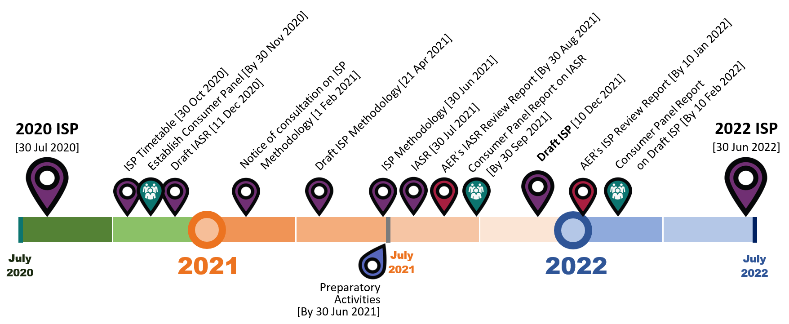
2022 ISP Timetable

Slide 14
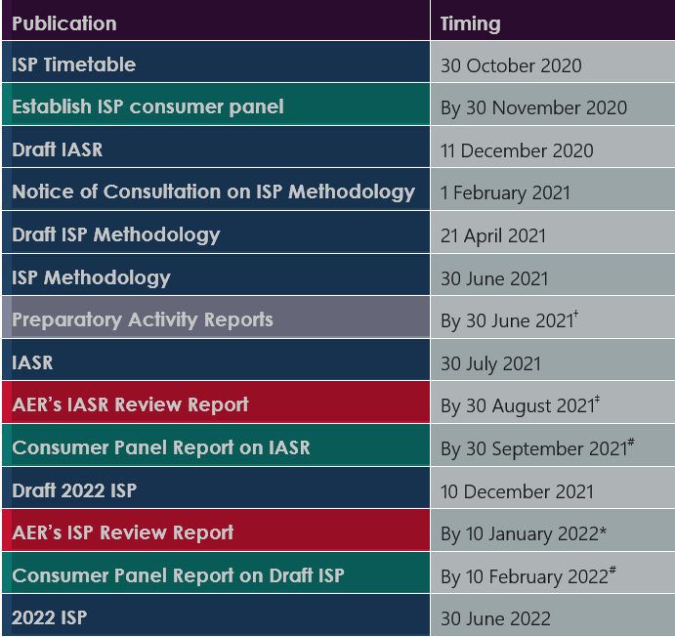
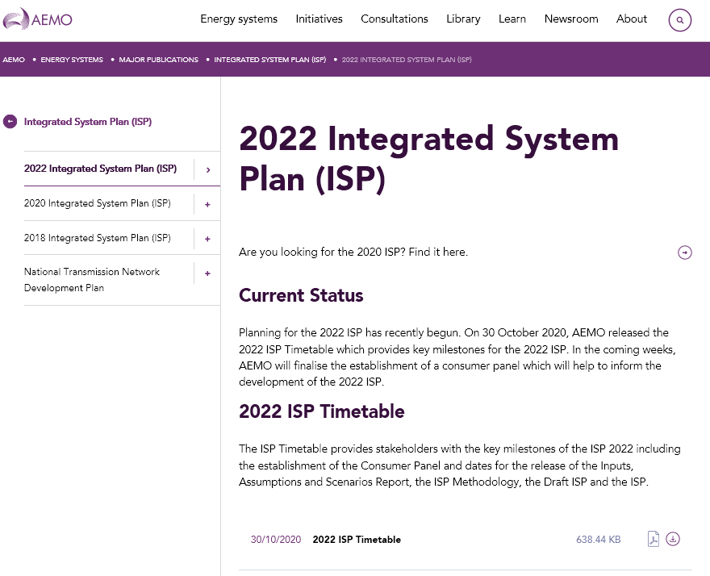
Upcoming events – 2022 ISP
AEMO’s website:
https://aemo.com.au/energy-systems/major-publications/integrated-system-plan-isp/2022-integrated-system-plan-isp
Please register by email for notices: ISP@aemo.com.au

Slide 15
Scenario planning is key to managing future risk, uncertainty – and opportunity

Slide 16
What is the value of scenario planning?
Scenarios, developed as narratives, allow us to:
Imagine possible future worlds
Recognise uncertainties, risks and opportunities
Collect multiple, diverse perspectives and challenge the conventional thinking
Consider adaptation strategies to build resilience
The set of scenarios should be:
Plausible
Distinctive
Internally consistent
Cover the breadth of possible futures
Explore the risks of over- and under-investment

Slide 17
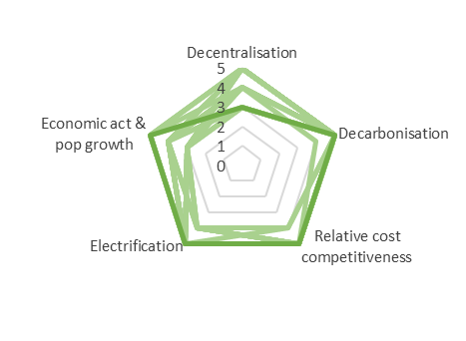
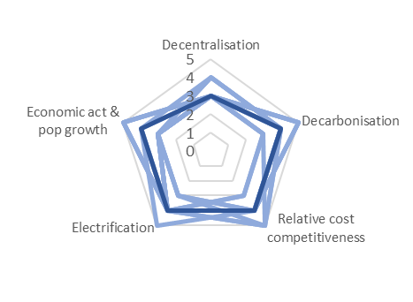
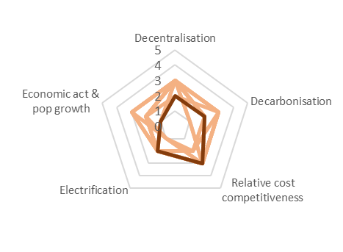
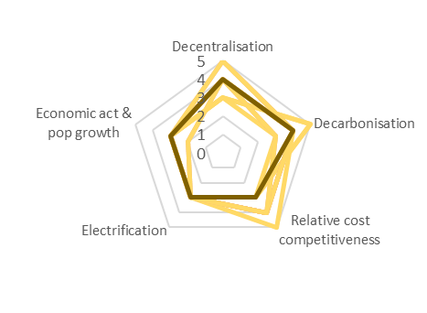
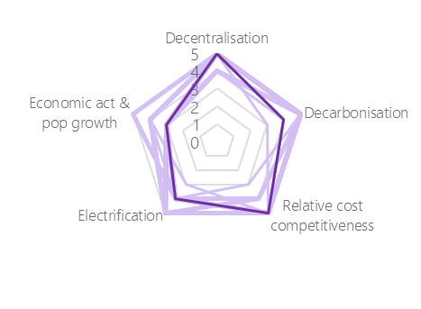
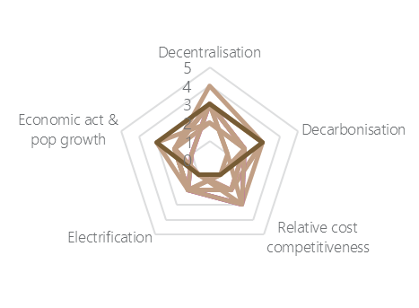
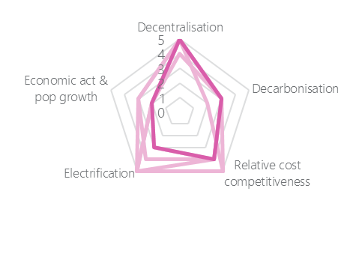
100+ stakeholder scenarios underpinned an initial set of scenarios for the workshops on the scenarios for the 2022 ISP
Scenario 1
Scenario 2
Scenario 3
Scenario 4
Scenario 5
Scenario 6
Scenario 7

Slide 18
Scenario consolidation – current view
Scenario feedback during the workshop and post-workshop survey suggested a degree of overlap between scenarios. We also considered that there may have been a lack of internal consistency in some scenarios
We have consolidated the seven scenarios into five, by:
  Merging two consumer-led scenarios (Scenarios 4 and 5) that had a focus on decarbonisation into a Sustainable Growth scenario;
  Dropping a scenario (Scenario 2) that overlapped with this new Sustainable Growth scenario;
  Reducing the level of decentralisation in a technology-centric scenario (Scenario 6) to be below Central in response to workshop feedback.
  Merging two scenarios (Scenarios 3 and 7) into a Slow Growth scenario, which maintains low economic activity and assumes a higher rooftop PV uptake than Central (to avoid energy costs).

Slide 19
Consolidated set of (base) scenarios
The Central scenario reflects a future energy system based around current government policies and best estimates of all key drivers.
Export Superpower scenario: Paradigm shift, with very high levels of electrification and significant hydrogen export opportunities, fuelled by strong growth and strong decarbonisation ambitions.
In the Sustainable Growth scenario, higher decarbonisation ambitions are supported by rapidly falling costs for battery storage which drive consumers action and higher levels of electrification of other sectors. These ambitions are supported by strong economic and population growth.
The Slow Growth scenario represents a sustained economic decline following the global pandemic which increases the likelihood of industrial load closures. Decarbonisation at a policy level takes a back seat, but the strong uptake of rooftop PV continues.
The Diversified Technology scenario reflects a world of targeted stimulus to aid the COVID-19 economic recovery, with low gas prices lowering consumer energy costs in the next decade. In the long-term, reductions in the cost of carbon capture and storage (CCS) provides further technology alternatives.
1
2
3
4
5
Scenario names subject to change.

Slide 20
Additional “risk” scenarios to explore risks
In addition to the narrative scenarios described above, AEMO is consulting on an additional set of risk-based scenarios
These aim to understand the sensitivity of investment decisions to changes in a single input parameter, or to an unexpected event.
More scenarios are presented here than are likely to be used in the modelling – seeking to get stakeholder input on which are considered to be most important for the ISP.

Slide 21
Additional risk scenarios
Central with early Victorian coal closure, and no timely firm capacity replacement
To explore the risks of a delay in replacing lost firm capacity.
Central with delayed Snowy and/or Humelink
To assess reliability impacts in NSW of delays in expected investment.
Central with early northern NSW coal closures
To assess reliability impacts on NSW of a reduction in capacity north of Sydney.
Central with the expanded TRET legislated
To explore value of Marinus, flow-on impacts in the Mainland
Sustainable Growth scenario with Central DER uptake
Compare the impact of a more transmission-focused decarbonising system.
Sensitivity to explore QLD specific risks
Other sensitivities have stronger impacts in other regions, possible QLD issues?

Slide 22
Additional sensitivity analysis
As well as the risk scenarios suggested above, more generalised sensitivity analysis will also be used to help determine the robustness of the optimal development plan in the ISP to possible changes in major inputs.
For example, these sensitivities may explore higher and/or lower:
  Generation costs
  Storage costs
  Transmission costs
  Discount rates
  Etc.

Slide 23
Integrated systems modelling is key to addressing economics and engineering objectives

Slide 24
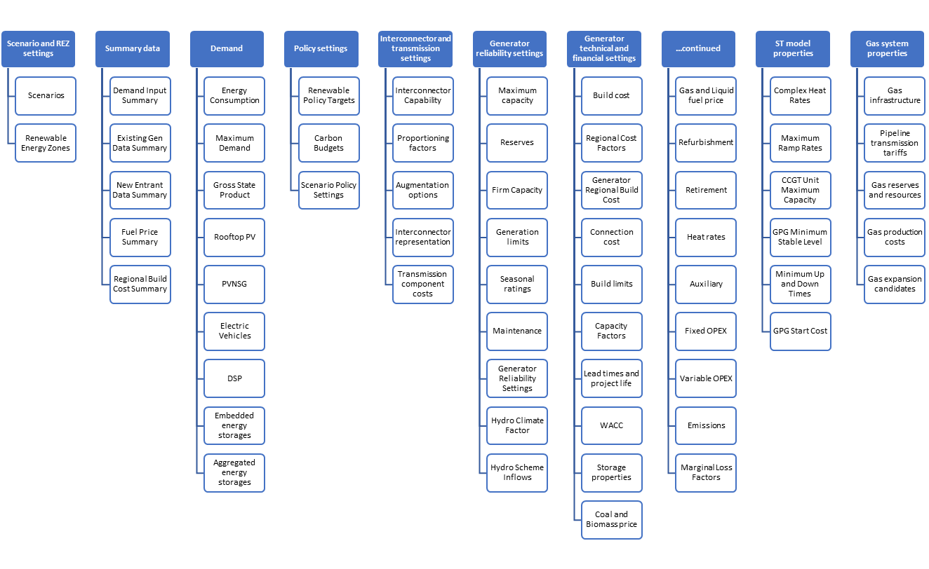
Inputs
Generator technical and financial settings
AEMO has undertaken extensive consultation to ensure its planning and forecasting publications are the highest possible quality, with data that is fit for purpose and industry reviewed.

Slide 25
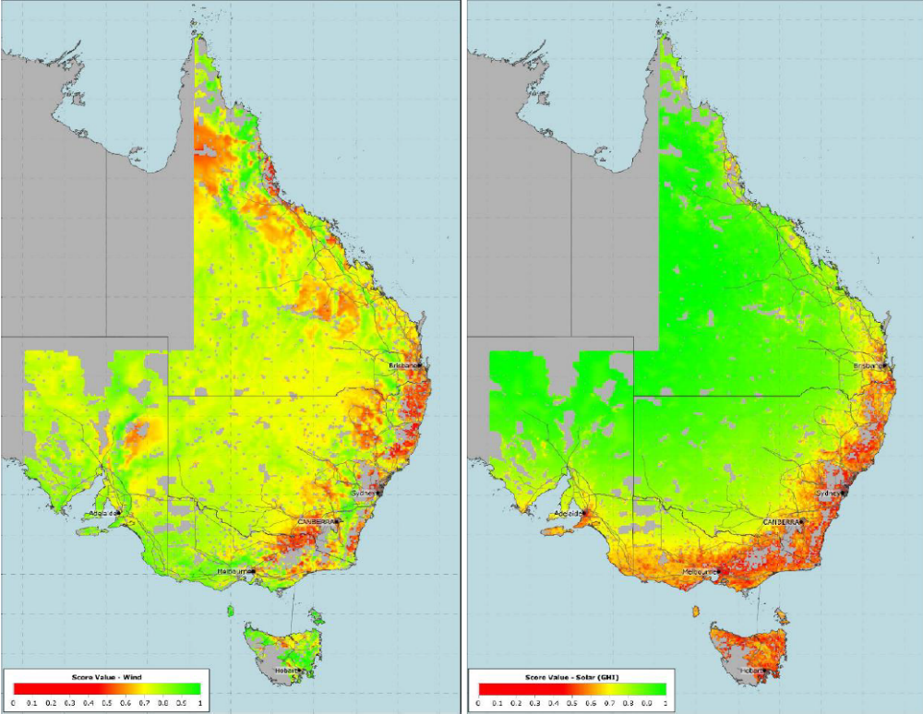
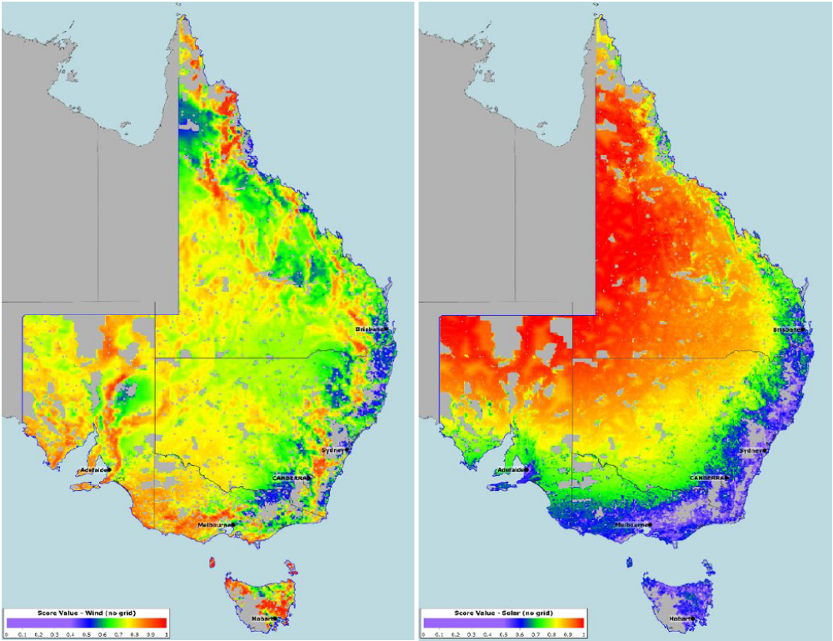
Candidate REZ Identification
Weighted Wind Weighted Solar
Considers: Resource quality, Correlation with demand, Land parcel density, Land cover, Road access, Terrain complexity, Population density, Protected areas, Electricity network + Alignment with developer interest and state initiatives (via consultation)
Notes:
10 factors

Slide 26
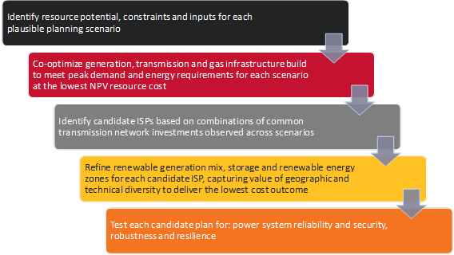
A systems approach to planning

Slide 27
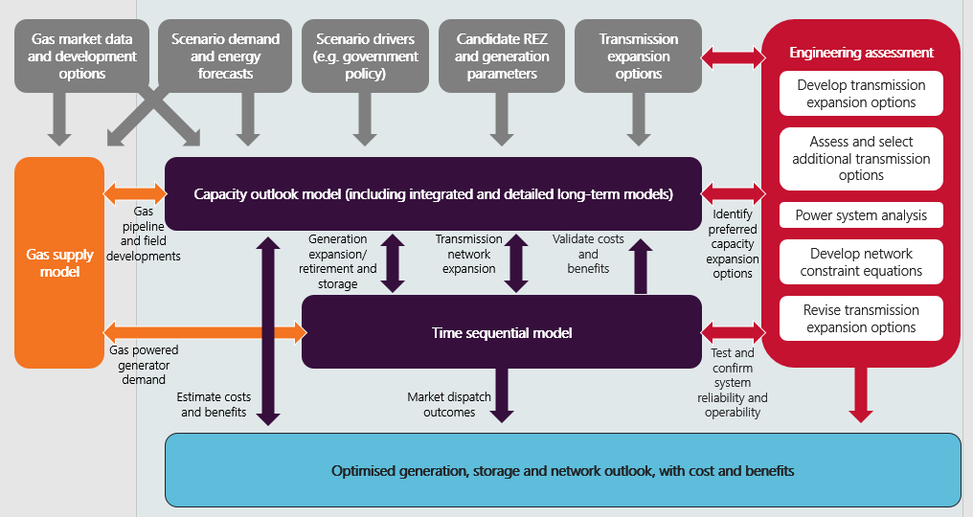
Overview of Integrated System Plan methodology

Slide 28
The 2020 ISP

Slide 29
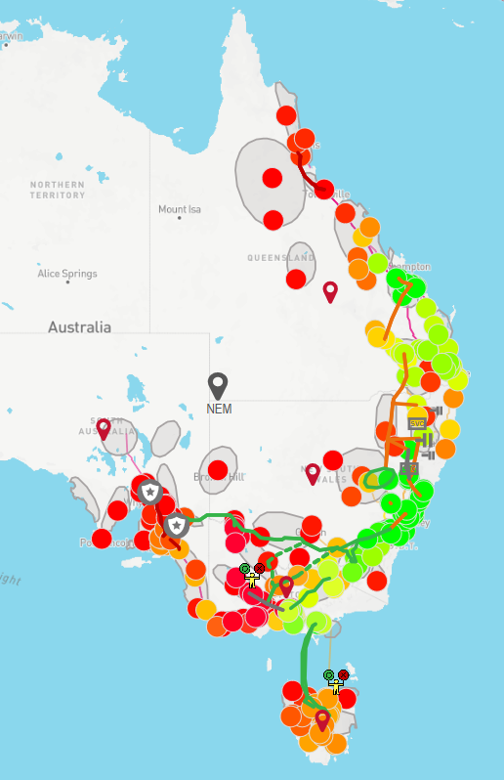
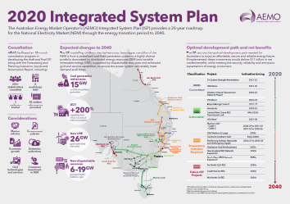
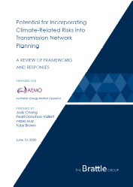
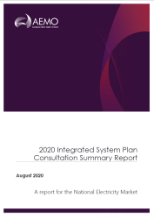
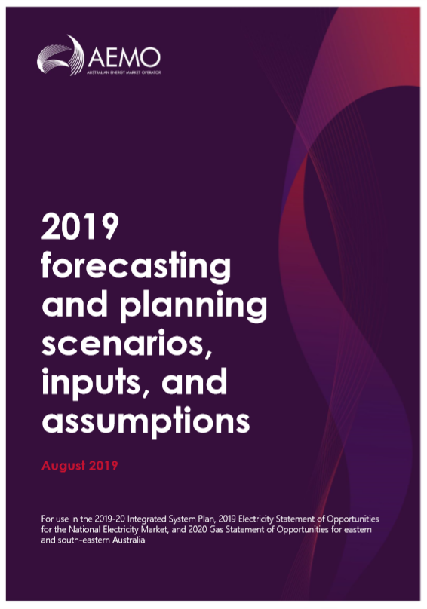
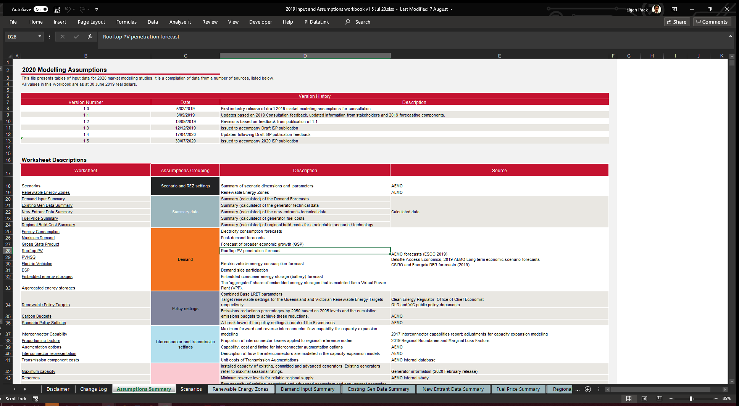

The 2020 ISP
The ISP web page:
https://www.aemo.com.au/energy-systems/major-publications/integrated-system-plan-isp/2020-integrated-system-plan-isp
2020 ISP – Main Report, Appendices & Supplementary Reports
Interactive map
ISP Inputs and assumptions
ISP database - traces
Consultation information
Chart data
Data files – generation and transmission outlook

Slide 30
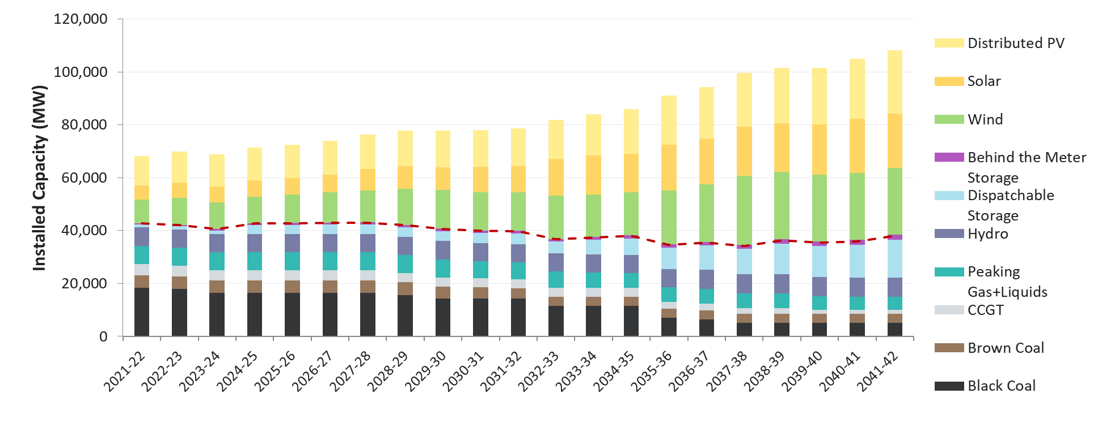
Generation mix, Optimal development path (central scenario) – 2020 ISP

Slide 31
The optimal development path (ODP) under Central scenario
Actionable
ISP projects
Development opportunities
Future ISP projects
*Regional VRE split:
11 GW QLD
12 GW NSW
6 GW VIC
3 GW SA
1 GW TAS
Project EnergyConnect by 2024-25 #
HumeLink by 2025-26#
VNI West by 2027-28 with decision rules
Future ISP projects with preparatory activities by 30 June 2021
Committed generation and transmission to proceed as planned
12 GW of additional DER (mainly distributed PV) required by 2040
33 GW* of additional VRE (solar and wind) generation required by 2040
13 GW of new dispatchable capacity (mainly storage) required by 2040
Future ISP projects no action before next ISP
VNI minor by 2022-23#
Central-West Orana REZ Transmission Link by 2024-25 #
Marinus Link by no later than 2031-32 with decision rules
# Estimated practical completion including any subsequent testing, project is optimal if can be delivered earlier
Notes:
Dane

Slide 32
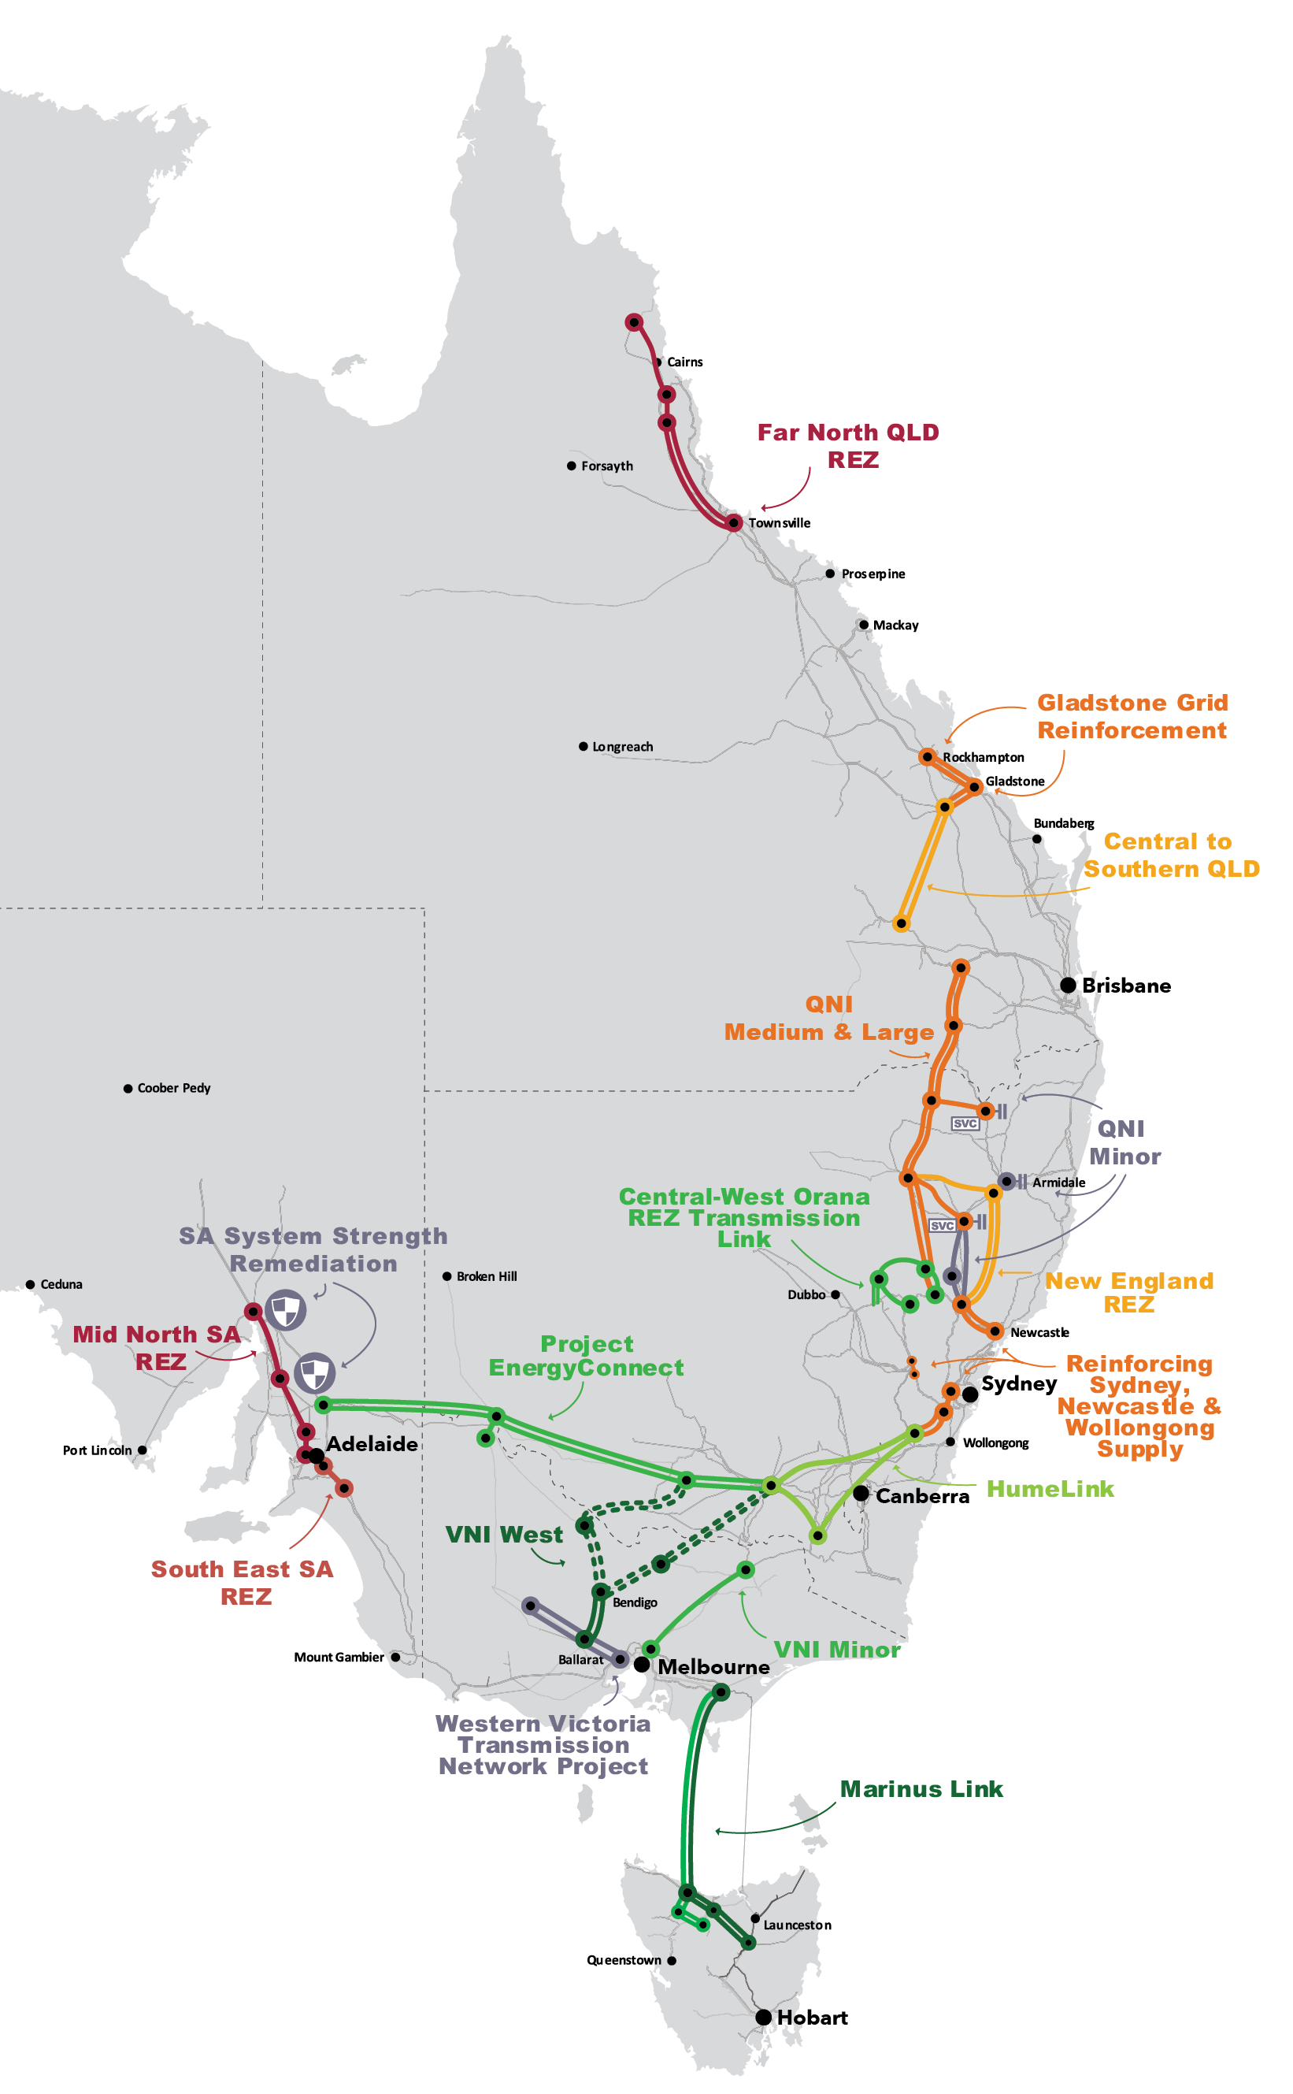
Necessary transmission upgrades
QNI: improve resource sharing, unlock REZs and provide grid resilience
Project EnergyConnect: improve resource sharing, unlock REZs and provide grid resilience.
Central-West Orana REZ Transmission Link: unlock a priority REZ identified in NSW Electricity Strategy
HumeLink: enable Snowy 2.0 to support NSW as coal-fired power stations close.
VNI West: provide Victoria with access to Snowy 2.0 and unlock REZs.
Marinus Link: enable Battery of the Nation and facilitate the TRET.
Source: AEMO 2020 ISP

Slide 33
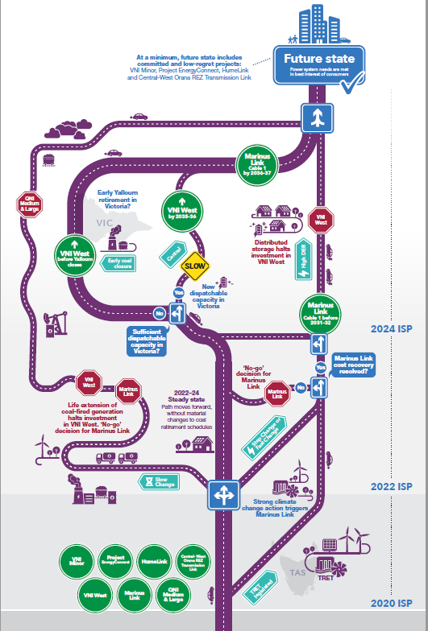
A dynamic roadmap with decision rules
Progress VNI West by 2027-28, with early works as soon as possible; and defer to 2035-36 or pause if:
  Transmission costs, including any 3rd party contribution, exceed $2.5 billion, or
  There is evidence that sufficient new market-based dispatchable capacity will be in place in Victoria head the next brown coal closure in Victoria, or
  There is evidence that the Slow Change scenario is unfolding, which includes life extensions of existing coal fired generation.
Progress Marinus Link, with early works as soon as possible, as follows:
  Stage 1 in 2028-29 - if TRET is legislated; and there is successful resolution as to how the costs of Marinus Link project how the costs will be recovered from consumers, and Slow Change scenario is not unfolding.
  Stage 2 in 2031-32 – if TRET implementation is on track, or the Step Change scenario is materialising (to be re-assessed and refined in the 2022 ISP)

Slide 34
Thankyou !

