Slide 1

UK’s analysis in planning for offshore network to meet clean energy goals
Dr. Biljana Stojkovska
Transmission Planning Technical Conference
02 February 2021

Slide 2

Why do we need Offshore Coordination?
Speaker: Luke Wainwright

Slide 3

Great Britain Net Zero Targets
The UK government has a target of net zero greenhouse gas emissions target by 2050
40GW of offshore wind is needed in Great Britain by 2030
Between 83 and 88 GW of network connected offshore wind is needed by 2050
Only 10 GW of offshore wind has been installed in Great Britain – requiring the pace at which that was delivered to be more than quadruped to meet net zero targets

Slide 4
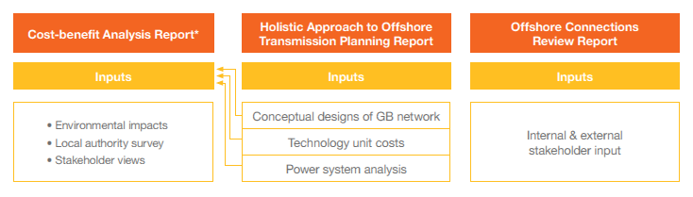
The Offshore Coordination Project
Phase One Scope

Slide 5





Offshore Network Coordination – Key Messages
-50% Assets
£6 billion (18%) potential savings by 2050 if integration starts from 2025 | The number of assets could be reduced by 50% creating significant environmental & social benefits | Benefits are reduced the later integration begins – by half if integration starts in 2030.
Flexibility is needed to deliver projects in train without putting their delivery and the 2030 offshore wind target at risk | Support for commercial deployment is needed to deliver all of the required technology | Additional onshore infrastructure is required to connect wind, however integration can minimise the overall increase in infrastructure

Slide 6
What is Offshore Coordination?
Speaker: Luke Wainwright

Slide 7
Overview Integrated vs Status Quo
Status quo - Project by project transmission build up | Integrated - Transmission asset sharing enabled
Requirements for each project considered separately | Takes account of possible future requirements
Only considers point-to-point offshore network connections | Considers a range of connection options including multi-terminal/meshed HVDC and HVAC options
Individual project optimisation and transmission (HVAC or HVDC) decision | Considers whole system optimisation and transmission technology decisions
Onshore and offshore network designs are considered separately | Considers effect on onshore system as part of offshore design development
Interconnectors are designed and connected separately | Possibility that interconnector/bootstrap capacity can be shared by an offshore wind farm
Local community impacts are managed on a project-by-project basis | Local community impacts considered on an overall impact basis
The increased levels of offshore wind mean there will be an increase in onshore infrastructure in all options.

Slide 8
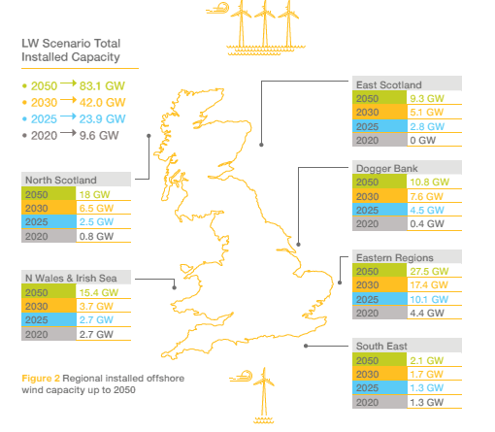
Overview Integrated vs Status Quo
Leading the Way Future Energy Scenario
  40 GW of offshore wind by 2030
  83 GW of offshore wind by 2050
  22 GW interconnectors in 2030 and 27 GW in 2050
To perform our analysis, we split the waters around Great Britain into six regional offshore wind development zones.

Slide 9
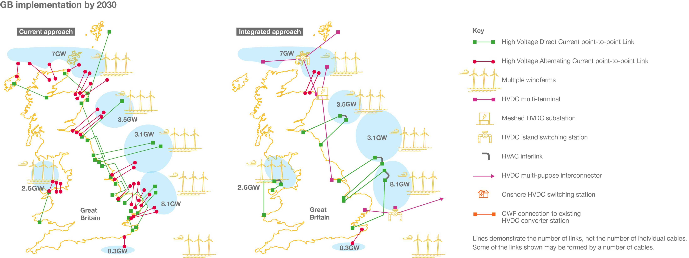
How it could look in 2030
Cost: £15 billion
Total Assets: 149
Cost: £12 billion (-17%)
Total Assets: 60% reduction

Slide 10
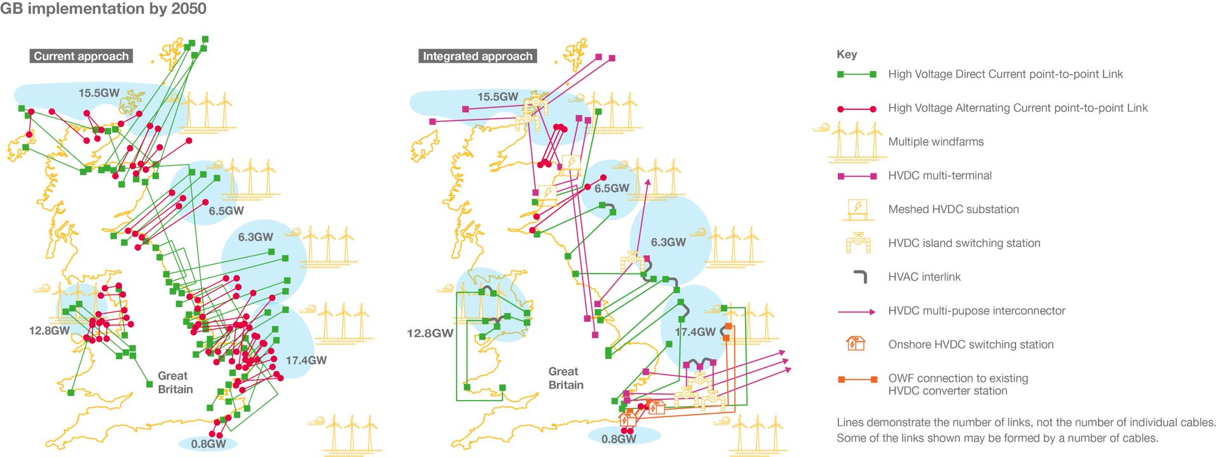
How it could look in 2050
Capex Cost: £29 billion
Total Assets: 330
Total Landing points: 105
Capex Cost: £23 billion (-18%)
Total Assets: 70% reduction
Total Landing points: 30

Slide 11
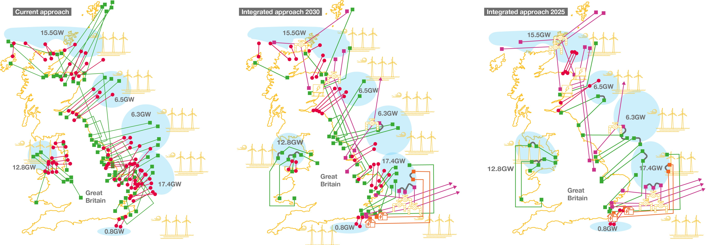
How it could look in 2050 – Sensitivity Analysis
Capex Cost: £29 billion
Total Assets: 330
Total Landing points: 105
Capex Cost: £27 billion (-8%)
Total Assets: 40% reduction
Total Landing points: 60
Capex Cost: £23 billion (-18%)
Total Assets: 70% reduction
Total Landing points: 30

Slide 12
Technology barriers and system risks to achieving the integrated option
Our work has highlighted key barriers and risks. These can be divided into technology availability and system risks.
Apart from the highlighted change to the Grid Code, an integrated approach could be implemented without progress on any of these recommendations.

Slide 13
Technology availability
There is a need for HVDC circuit breakers (DCCBs) to be progress to commercial use in Europe
DCCBs have been used in three projects in China but not at transmission levels in Europe
Almost all the HVDC systems in operation today have been developed as point-to-point systems without the use of circuit breakers
Where?
The Integrated option utilises DCCBs in two locations in Scotland, which we consider the optimal approach for transporting electricity further south.
What happens if they don’t progress to commercial use?
However, an integrated design can be developed in alternative ways if DCCBs are not available. If this was the case there would be additional network infrastructure required, coming at an additional cost. This would also have the potential to increase the likelihood of network faults and therefore impact on system reliability and operability.

Slide 14

Technology continued
Higher capacity HVDC submarine and underground cables need to be brought to commercial use in Europe to enable the power transmission from offshore to onshore at the capacities envisaged in the Integrated option if the change to the SQSS standard is made.
The proposed Integrated option assumes that individual cables with capacities of 1.8 GW are available by 2040. Two such cables together in a bi-pole arrangement will allow connections of 3.6 GW. Currently, the highest individual HVDC cable capacity that is widely available is 1.4 GW, with higher capacities limited in supply options.
A targeted innovation strategy and support for early commercial use is required
No other material HVAC or HVDC critical technology or asset dependencies that would impact development of an offshore integrated network

Slide 15
Impact of System risk on Offshore Integration
In order to deliver the benefit of the Integrated option we have identified that some changes are required to technical network codes and standards.
SQSS
Cost-benefit analysis aligning on and offshore infeed loss limits
Grid Code clarify rules in relation to integrated HVDC-connected offshore windfarms
A targeted innovation strategy and support for early commercial use is required
No other material HVAC or HVDC critical technology or asset dependencies that would impact development of an offshore integrated network
Work to understand these changes and their impact should commence immediately to reduce the likelihood of missed opportunities

Slide 16
What’s next for Offshore Coordination?
Speaker: Luke Wainwright

Slide 17
Offshore Coordination Project
Phase Two Scope
More Detailed Technical Analysis:
Early Opportunities:
Identifying and delivering innovative and flexible approaches to connecting projects already in progress​
Roadmap of Code Modifications:
Agreement and delivery of a roadmap of industry commercial and technical codes and standards​
Assessment of required technical codes and standard changes
Aligned closely with BEIS and Ofgem pathfinder projects ​
Assessment of transmission charging impact
Development of enabling activities such as an ongoing process for technical planning, coordination and operation building on the Pathway to 2030 work
ESO Offshore Coordination Strategy:
Develop long term ESO Offshore Coordination objectives
Ensure all workstream align with strategic direction from OTNR
Agree ESO role in the enduring offshore transmission regime
The development of technical planning, coordination and operating standards​
The development of more detailed offshore network designs based on agreed scenarios​
Phase 2 intends to progress the activities within the OTNR within the ESO’s remit:

