Slide 1
Market Design Alternatives
Energy-Only Market
January 25, 2021
Prepared For
Presented by
New England States’ Energy Vision
Wholesale Market Design
Day 2 Technical Forum
Kathleen Spees

Slide 2
What is an “Energy Only” Market?
Introduction
An energy only market is a market-based approach to meeting resource adequacy needs (an alternative to the capacity market)
An energy only market would:
Eliminate the capacity market
Increase energy market scarcity prices during tight supply conditions (producing price spikes high enough to attract new entry when needed)
Energy-only market by itself does not address carbon emissions. States would need to utilize other mechanisms to achieve decarbonization such as higher carbon pricing, a clean energy market, subsidies, or state contracts

Slide 3
How Does an Energy-Only Market Achieve Resource Adequacy?

Slide 4
There are several ways to achieve resource adequacy:
How it Works
Market-Based Options
Vertically Integrated/ Planned
Energy-Only Market
Capacity Market
Vertically integrated utilities or a government entity does resource planning to build or contract new resources
Energy prices (plus “scarcity price” during tight hours) is primary mechanism to attract new investments
Organized market for “capacity” product is primary mechanism to attract new investments
MISO, California, SPP, Ontario
ERCOT, Alberta, Australia
ISO-NE, PJM, NYISO, UK, Ireland

Slide 5
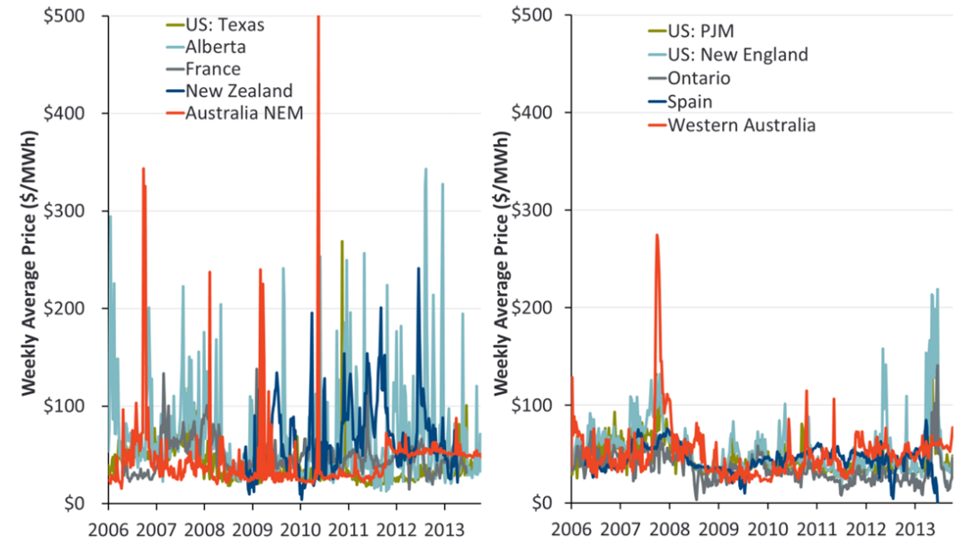
Energy-only and capacity markets both use competitive prices to attract new supply investments
How it Works
Energy-Only Markets
Capacity Markets
No capacity payments
Investments attracted through occasional high price spikes if reserve margins fall
Higher price volatility & somewhat lower reliability compared to today’s capacity market
Energy prices are more stable and lower on average
Investments attracted through capacity market payments
See Spees & Newell discussion of alternative resource adequacy constructs.

Slide 6
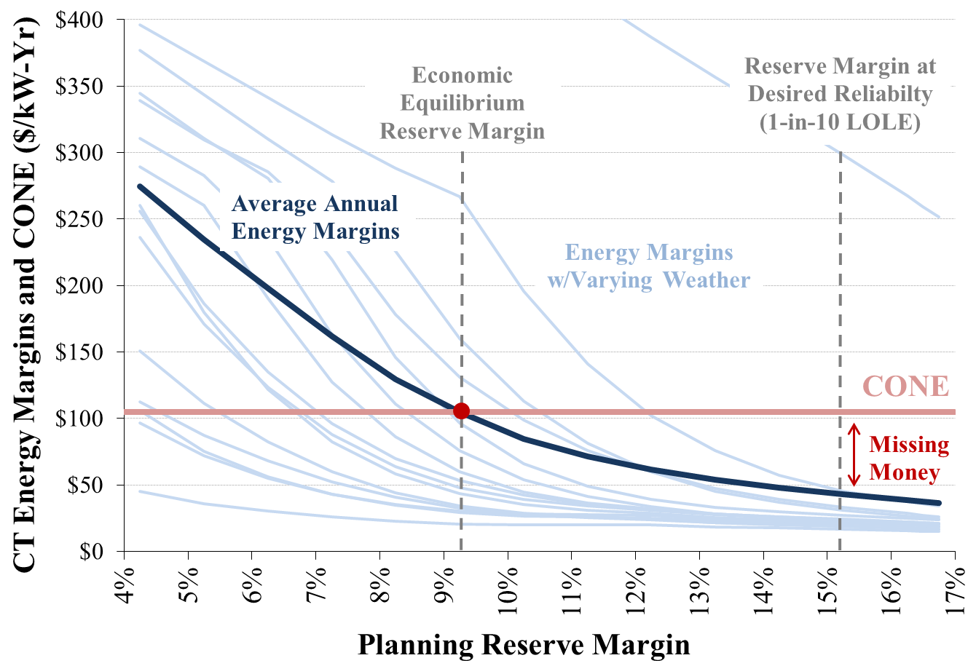
An energy-only markets tend to produce somewhat lower reserve margins (and lower costs) than capacity markets
How it Works
Texas Example: Power Plant Energy Market Net Revenues
Energy-Only
Reserve margin and reliability determined by market forces (no minimum reliability standard)
Capacity Market
1-in-10 reliability standard is set by policy and guaranteed through capacity market auctions
Net Energy Market Revenues ($/kW-year)
Cost of a Power Plant
Capacity payments to attract more investments & achieve 1-in-10 reliability standard
In Texas we estimated 1% greater customer costs in the long run compared to energy-only
See Brattle’s 2012 and 2014 analyses of capacity and energy-only market options in Texas.

Slide 7
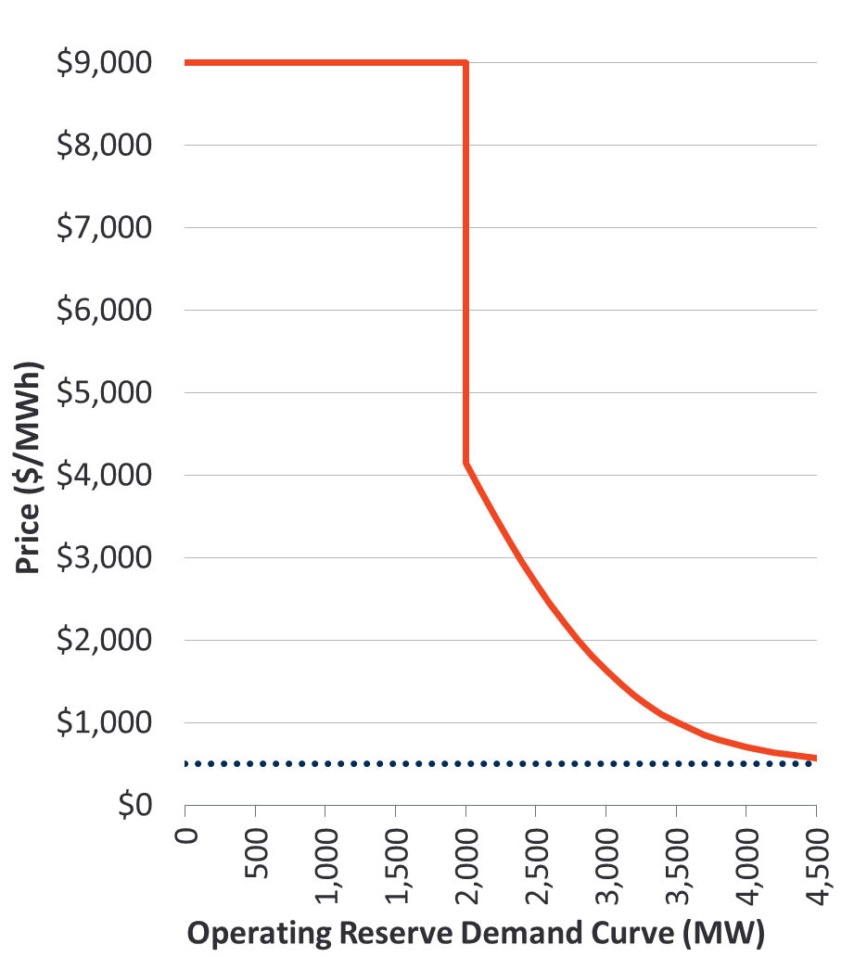
Energy-only market relies on enhanced “scarcity pricing” during short-supply events
How it works
Several essential reforms to the energy and ancillary markets will be critical to grid transition:
Higher energy price cap
Enhanced administrative scarcity pricing
Improved ancillary service markets to support system balancing and flexibility (new products, greater quantities)
Enable full participation of emerging clean technologies for essential reliability services (DR, DER, storage, EVs, imports)
Texas: Operating Reserve Demand Curve
Price cap at the value of lost load (VOLL)
Energy Price
Increases toward the cost of involuntary load shedding as the system approaches shortage events
Very high, short-duration price spikes are necessary in a high renewable system to incentivize quick-responding DR, storage, and other resources to respond quickly to address system needs
These reforms should be pursued in any case in New England, but must be in place prior to eliminating the capacity market if reliability is to be maintained in an energy-only market
Marginal Energy Cost
Source: The Brattle Group, Estimating the Economically Optimal Reserve Margin in ERCOT, January 31 2014

Slide 8
How Would an Energy-Only Market Align with State Policy Goals?

Slide 9
How are state policies accounted for and supported?
State Policies
A well-designed energy-only market can readily accommodate state policies, but will not help to achieve decarbonization goals
State policies are better accommodated by energy-only because:
But energy-only will not help achieve decarbonization goals because:
Minimum offer price rule (MOPR) would be eliminated
Needed reforms to energy and ancillary service markets will be prioritized (by necessity)
Energy-only markets achieve reliability at low cost (indifferent to carbon emissions)
Least cost resources that enter or stay in the market may continue to be fossil plants
States will need to utilize other policy or market mechanisms to attract and retain clean resources (e.g. carbon price, state contracts, clean energy market)

Slide 10
Alignment with State Principles

Slide 11
How does an energy-only market align with the five principles in the States’ Vision Statement?
State Principles
State Principle | Aligned with State Principles?
1. Meet States’ decarbonization mandates and maintain resource adequacy at the lowest cost by using market-based mechanisms | No: Does not help to meet carbon goals, but neither does it interfere with other state programs Maybe: Maintains resource adequacy, but at a lower level than the current market Yes: Market-based
2. Establish effective mechanisms that accommodate existing and future long-term contracts for clean energy resources executed pursuant to state law | Yes
3. Integrate distribution-level resources effectively and efficiently | Yes, if done well
4. Allow interested buyers and sellers to participate | Yes
5. Provide for an appropriate level of state involvement in market design and implementation | No change from today

Slide 12
Market Design Alternatives
Integrated Clean Capacity Market
January 25, 2021
Prepared For
Presented by
New England States’ Energy Vision
Wholesale Market Design
Day 2 Technical Forum
Kathleen Spees

Slide 13
What is the “Integrated Clean Capacity Market”?
Introduction
The ICCM would be a scalable, technology-inclusive forward clean energy procurement mechanism to meet regional clean energy goals affordably
ICCM Would:
Meet all system and local capacity needs, building on “what works” within the current capacity market and addressing current limitations
Offer states and customers a market-based vehicle for procuring clean energy to meet a portion or all state policy goals (and maintaining flexibility to meet clean energy needs through non-ICCM programs)
Note: Another variation of this concept is the Forward Clean Energy Market (FCEM), which is an earlier iteration of the same design concept of market-based clean energy procurement. The FCEM would maintain separate auctions for capacity and clean energy attributes. This presentation focuses on ICCM as the preferred first-best option.

Slide 14
How Does the ICCM Market Achieve Resource Adequacy and Clean Energy Needs?

Slide 15
How would the ICCM work?
How it works
States
Set clean energy goals and clean energy resource qualification standards Determine quantity of clean energy to buy through the ICCM
RTO
Determines quantity of capacity needed for reliability (regionally and by location)
Buyers & Sellers
Fossil generation: can sell capacity Clean resources: can sell both capacity and clean energy Voluntary buyers (cities, companies): can procure additional clean energy
Auction Administrator
Three-year forward auction Least-cost procurement to meet both capacity and clean energy needs Separate prices for: (1) MW of capacity, and (2) MWh of clean energy attribute credits (CEACs) 7-12 year price lock-in for new resources

Slide 16
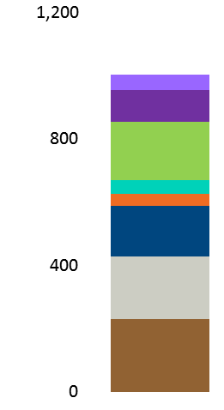
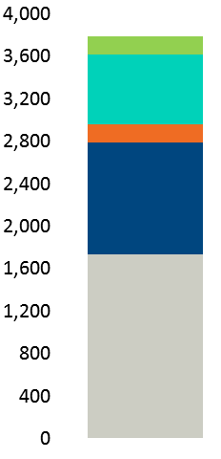
The ICCM would meet capacity and clean energy needs at the lowest combined cost
How it Works
BIDS
CO-OPTIMIZED AUCTION CLEARING
CLEARING RESULTS
Demand
Similar to Current Capacity Market Clearing
Objective function: Maximize social surplus (area under demand curves minus cleared resource cost)
Cleared resources: Least cost resources for meeting capacity & clean energy demand
Price setting: Marginal cost of meeting incremental demand
Clearing Prices
Cleared Resources
Capacity (MW)
Clean Energy (CEACs)
Capacity
Higher price
Higher price
Cleared
Capacity
Resources
Higher price
More capacity
More clean energy
Supply
Total annual resource cost ($) Capacity quantity (UCAP MW) Clean attribute quantity (CEAC)
More capacity
Clean Energy
Cleared
Clean Energy
Resources
Higher price
More clean energy

Slide 17
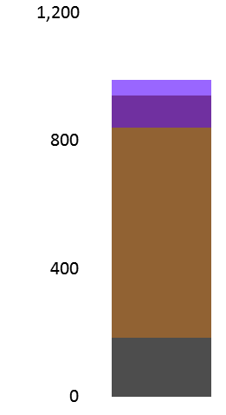
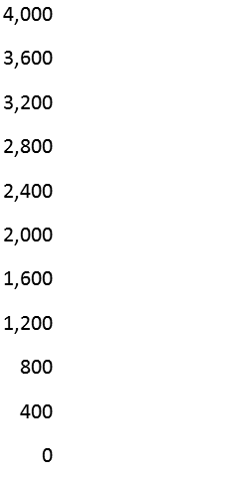
What resources clear?
How it Works
Traditional Capacity Market
Integrated Clean Capacity Market
Cleared Capacity
UCAP MW
Cleared CEACs
GWh
Cleared Capacity
UCAP MW
Cleared CEACs
GWh
EE
DR
No CEACs Procured
EE
DR
Battery
Wind
Solar
Hydro
Nuclear
Gas
Gas
Coal
Note: Auction clearing and pricing is model available upon request.
Simplified example is not intended to reflect New England.

Slide 18
How Would the ICCM Align with State Policy Goals?

Slide 19
How would States and customers express demand for clean energy?
State Policies
Customer-first approach offers flexibility to the demand side of the market to define what clean attributes they value and how much
Each State would have options to:
Voluntary buyers would have options to:
Define eligible resource types
Set technology-specific carve-outs
Procure attributes through state-defined renewable energy credit (RECs), state-defined zero emissions credit (ZECs), or a new resource-neutral regionally-defined clean energy attribute credits (CEACs)
Buy as much (or as little) clean energy as they like
Continue using other clean energy programs and procurements outside of ICCM
Set budget or price caps
Express demand as a vertical demand curve, sloping demand curve, or price-quantity pairs
Define eligible resource types or state/regional credits
Buy as much (or as little) clean energy as they like
Self-supply within state mandates
Express demand as price-quantity pairs

Slide 20
Indicative demand curve for a state with a 70% clean energy target
State Policies
Clean Energy Price
($/MWh)
Clean Energy Demand Curve
Demand curve decarbonizes faster & cheaper by buying more clean energy when prices are low
(price cap)
Legacy Contracts and Other State Programs Outside of ICCM
(20%)
In-Market Clean Energy Procurements
(50%)
(price @ “clean net CONE”)
0%
70%
100%
Quantities accounted for but no clean energy payments are awarded
Clean Energy Demand, as % of load
(Structured to meet 70% mandate, or accelerate to 100% if prices are low)

Slide 21
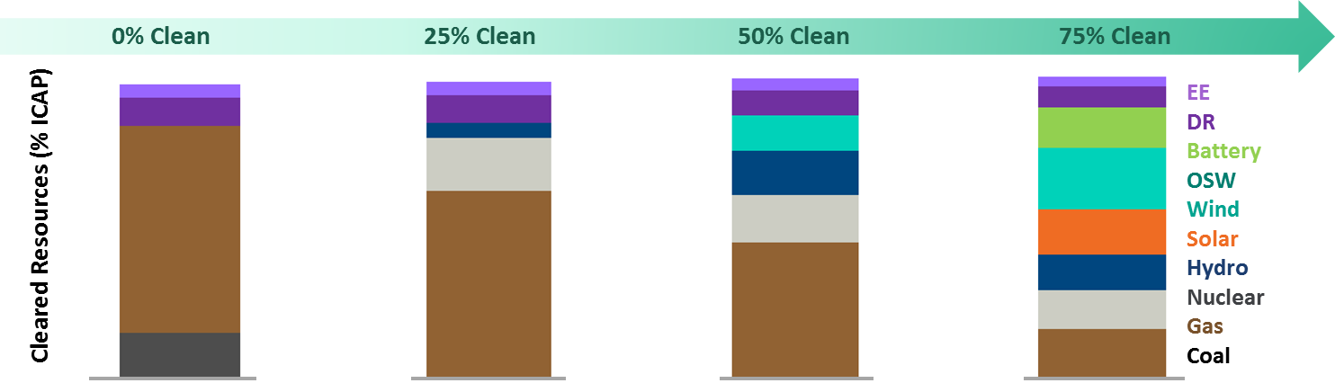
How could the ICCM guide the clean energy transition reliably and affordably?
State policies
State mandates for clean energy would increase over time, driving a least-cost pathway to a cleaner grid
Note: Illustrative auction clearing and pricing model used to develop this example is available upon request. Simplified example is not intended to reflect New England.

Slide 22
Alignment with State Principles

Slide 23
How does an ICCM align with the five principles in the States’ Vision Statement?
State Principles
State Principle | Aligned with State Principles?
1. Meet States’ decarbonization mandates and maintain resource adequacy at the lowest cost by using market-based mechanisms | Yes: Achieves state clean electricity mandates Yes: Maintains resource adequacy Yes: Market-based
2. Establish effective mechanisms that accommodate existing and future long-term contracts for clean energy resources executed pursuant to state law | Yes
3. Integrate distribution-level resources effectively and efficiently | Yes, if done well
4. Allow interested buyers and sellers to participate | Yes
5. Provide for an appropriate level of state involvement in market design and implementation | Yes: States set their own demand for clean energy procurement Maybe: Design, implementation, and rules change processes are not yet determined

Slide 24

Contact Information
Dr. Kathleen Spees is a principal at The Brattle Group with expertise in wholesale electricity markets design and environmental policy analysis.
    Dr. Kathleen Spees is a Principal at The Brattle Group with expertise in designing and analyzing wholesale electric markets and carbon policies. Dr. Spees has worked with market operators, transmission system operators, and regulators in more than a dozen jurisdictions globally to improve their market designs for capacity investments, scarcity and surplus event pricing, ancillary services, wind integration, and market seams. She has worked with U.S. and international regulators to design and evaluate policy alternatives for achieving resource adequacy, storage integration, carbon reduction, and other policy goals. For private clients, Dr. Spees provides strategic guidance, expert testimony, and analytical support in the context of regulatory proceedings, business decisions, investment due diligence, and litigation. Her work spans matters of carbon policy, environmental regulations, demand response, virtual trading, transmission rights, ancillary services, plant retirements, merchant transmission, renewables integration, hedging, and storage.
    Dr. Spees earned her PhD in Engineering and Public Policy within the Carnegie Mellon Electricity Industry Center and her MS in Electrical and Computer Engineering from Carnegie Mellon University. She earned her BS in Physics and Mechanical Engineering from Iowa State University.
Kathleen Spees Principal, Washington DC +1.202.419.3390 Kathleen.Spees@brattle.com

Slide 25
Appendices

Slide 26
ICCM Key Design Elements
ICCM
Design Element | Resource Adequacy Objectives | Clean Electricity Objectives
Who Sets Demand? | RTO | State policymakers Voluntary buyers (retailers, companies)
Product Definition | Unforced capacity (UCAP MW) Keep locational specificity (as today) Accurate accounting of capacity needs and values of resource types | Clean energy attribute credit (CEAC) State-policy-differentiated CEACs to meet carve outs Consider: CEAC accreditation tied to carbon abatement value
Supply Eligibility | All clean and fossil resources are eligible ELCC-based accounting for resource-neutral capacity values (by location, season, and flexibility) | Renewable resources across New England Each state determines eligibility for their own in-state nuclear Each state can specify eligible technologies (but aim to limit cross-state differences to maximize competition)
Quantity to Procure | Quantity needed to support 1-in-10 Based on advanced reliability modeling that considers emerging flexibility needs in the clean grid Consider: State option to impose a maximum on the share of capacity procured from fossil plants | States and customers decide the quantity needed Pre-existing contracts enabled as self-supply In vertically integrated or other Fixed Resource Requirement states, the resource mix is approved by the state and not subject to ICCM
Willingness to Pay for Each Product | Sloping demand curves for each system-wide and locational capacity requirement Consider: Separate demand curves for summer/winter needs and “flexible” capacity needs | States submit sloping demand curves for state-mandated clean energy demand Voluntary buyers can submit price-quantity pairs to exceed state mandates

Slide 27
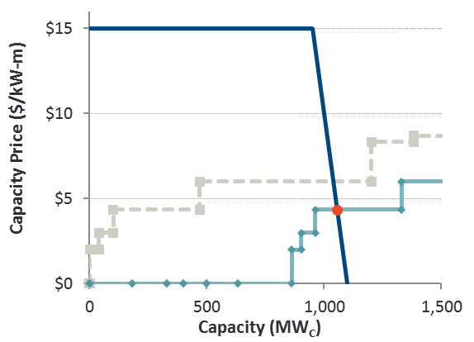
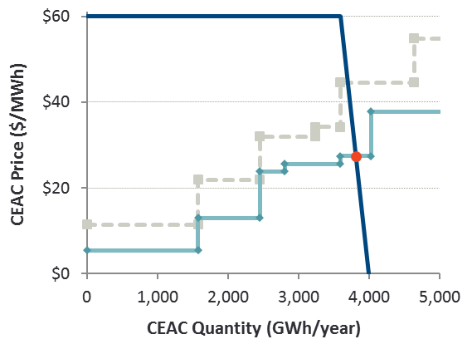
How are prices set?
ICCM
Co-optimized price formation reflects marginal cost of each product.
Capacity Clearing
Clean Energy Clearing
Clean Energy Offer Prices
(If resources earned no capacity revenues)
Capacity Offer Prices
(If resources earned no clean energy revenues)
Clean Energy
Attribute Price
Capacity Offer Prices
(Accounting for clean attribute revenues)
Clean Energy Offer Prices
(Accounting for capacity revenues)
Capacity (UCAP MW)
Note: Simplified example. Not intended to reflect New England. Simplified clearing model available upon request.

